Slide 1
WINNERS OF THE SUNHSHINE SYMBOL ART COMPETION
Thank you to everyone who tried: certificates on their way!

Slide 2
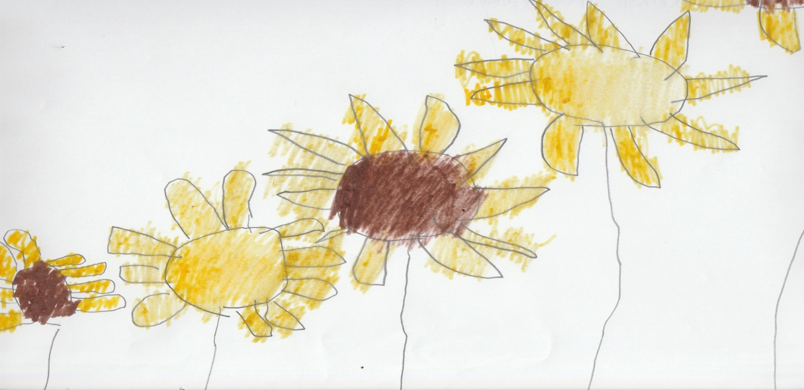
WINNNER OF THE CHILDREN’S INDIVIDUAL Daniel Treadwell

Slide 3
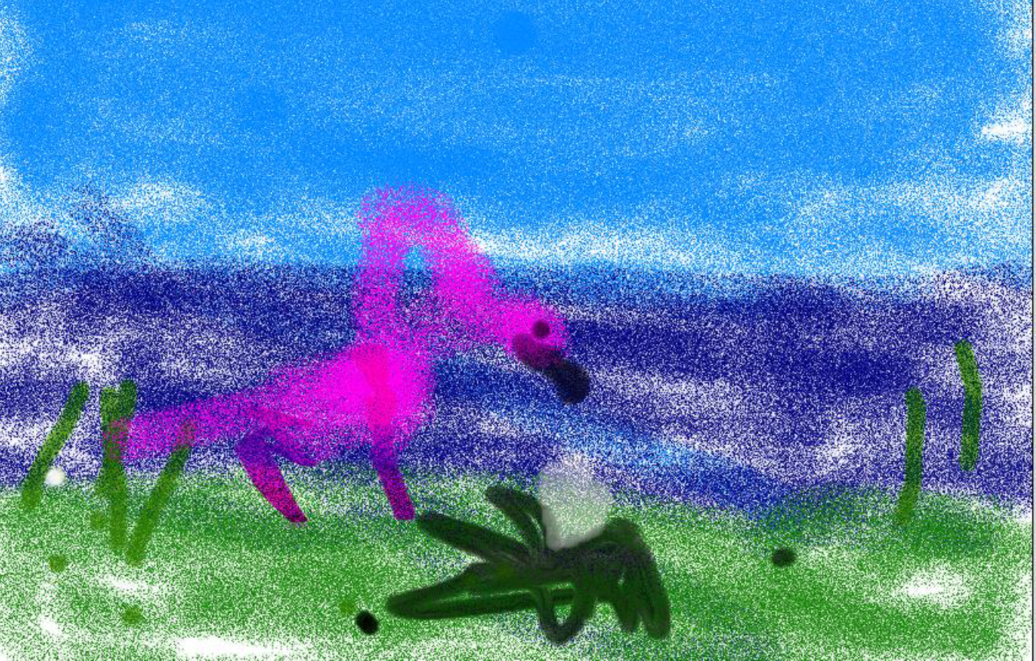
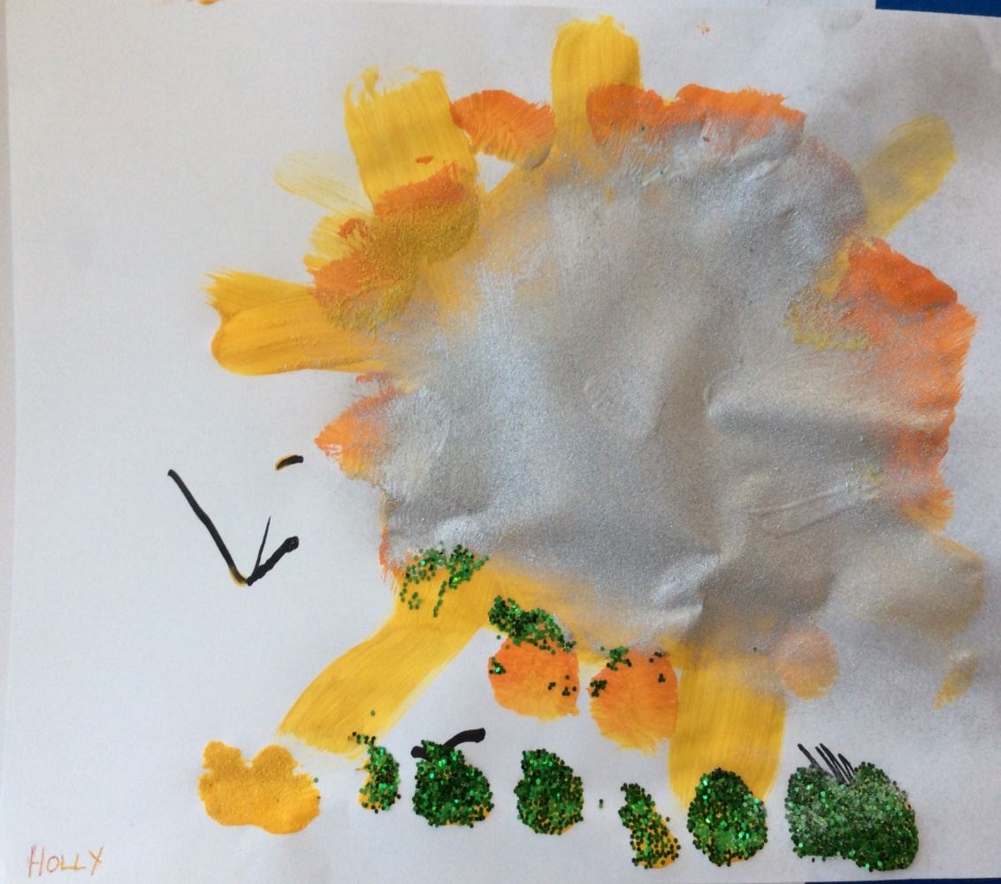
Runners Up Hollie, 7 (eyegaze) and Holly McKitrik, aged 9

Slide 4
School Group Prize: Collage, Hillside School

Slide 5
ADULT GROUP PRIZE Ejovi Onobrauche and Paula Curtis with Mary Israel Athol House (Leonard Cheshire)

Slide 6
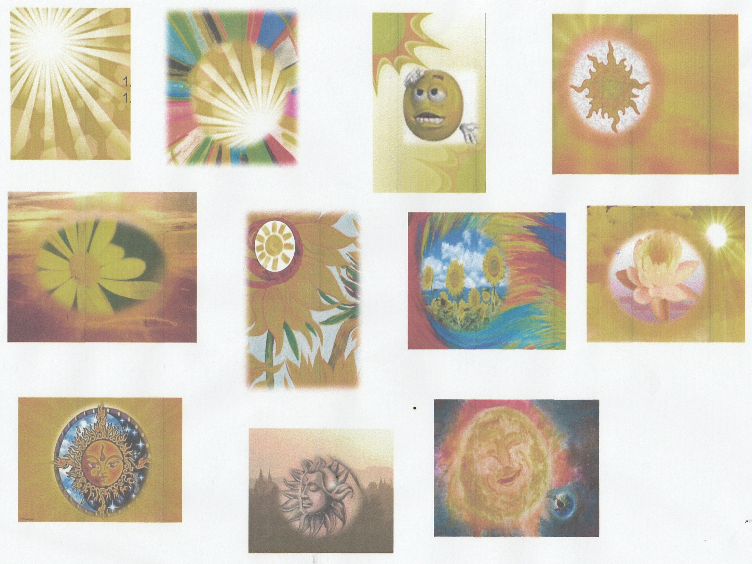

Slide 7
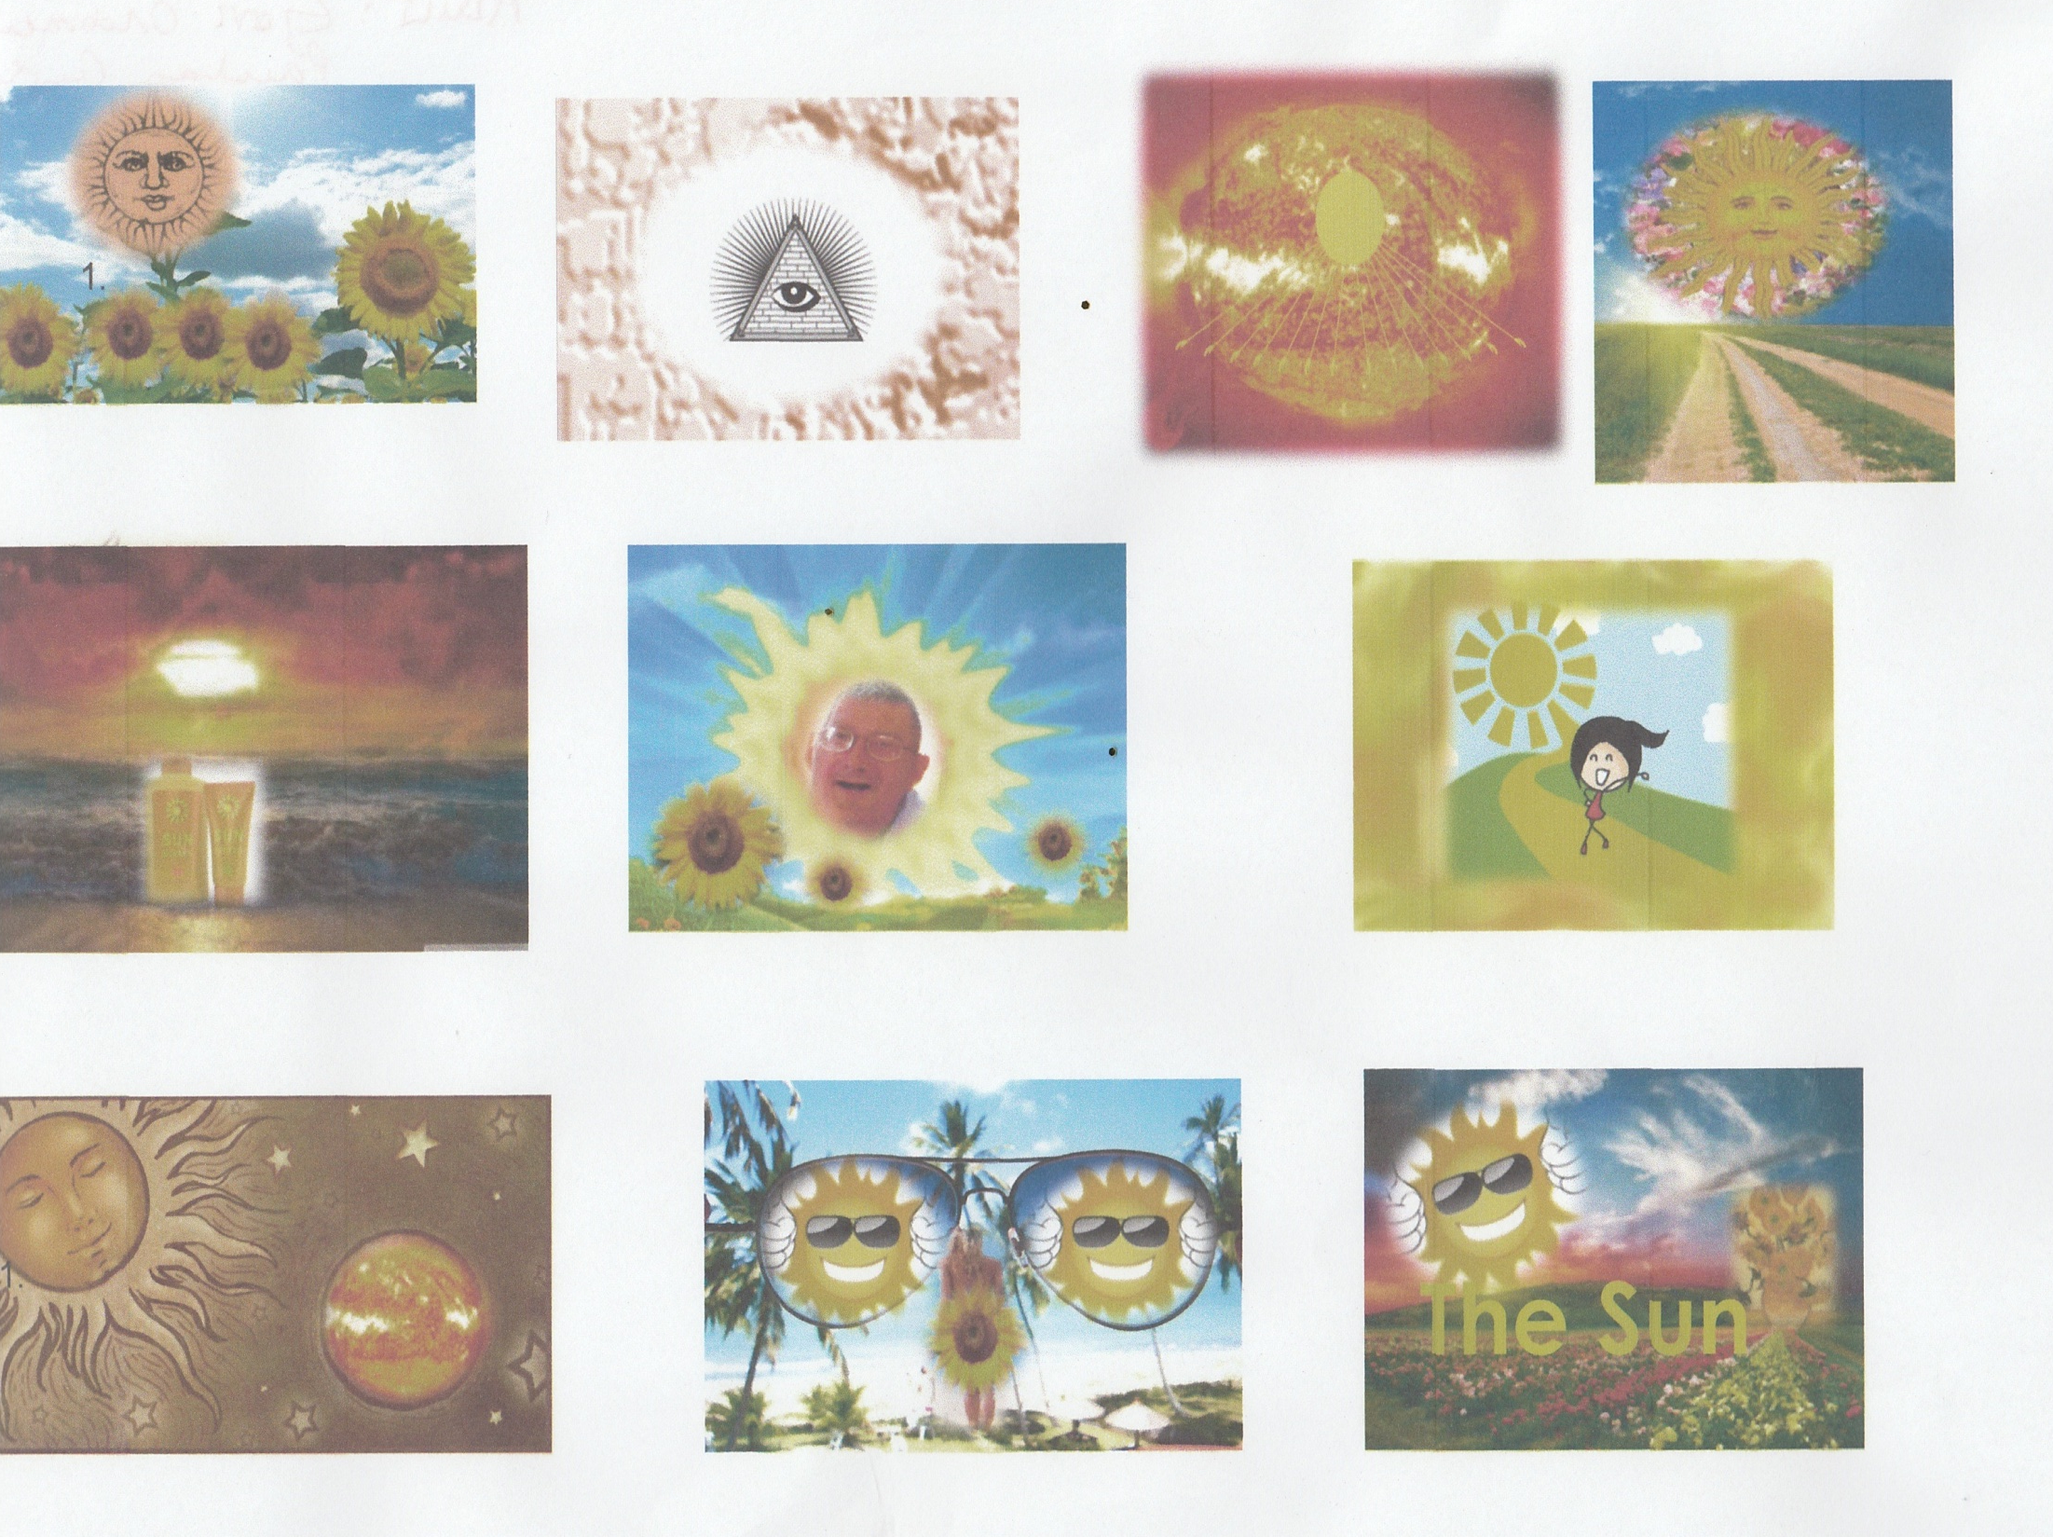

Slide 9
Individual Adult Prize

Slide 10
Jemima Hughes (adult)

Slide 11
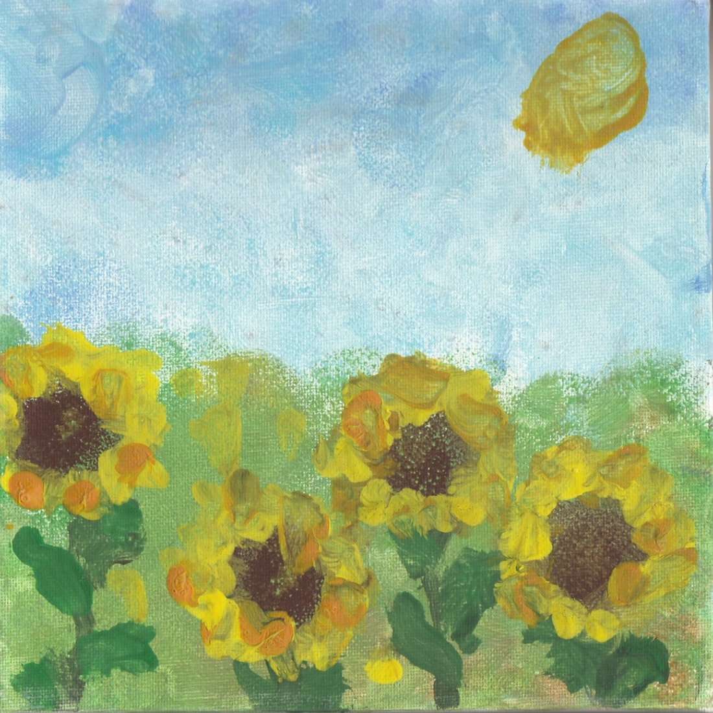
Runners Up Charlie Gibbons (Ireland Wood) Phil Alne Hall, York

