Slide 1
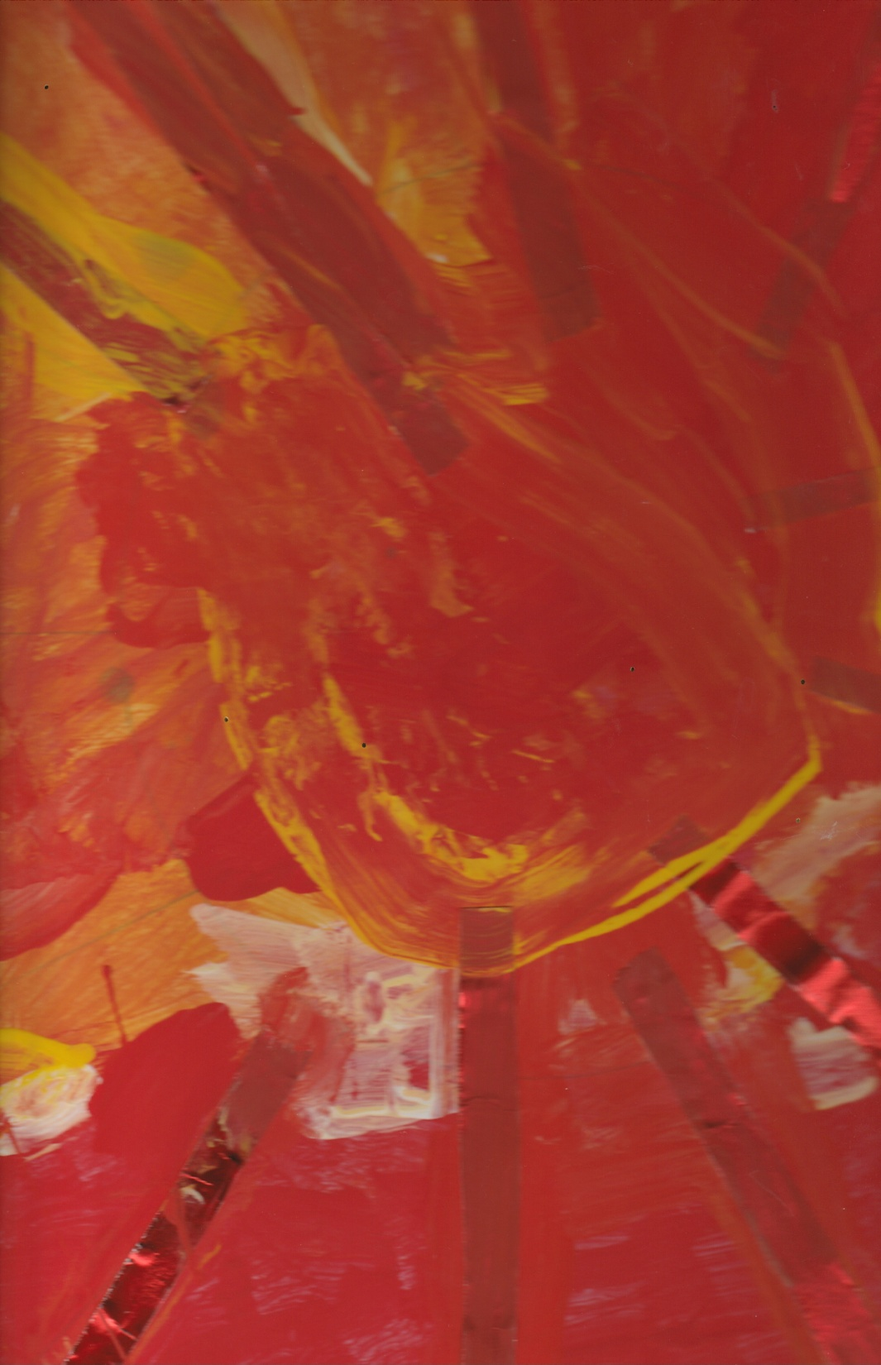
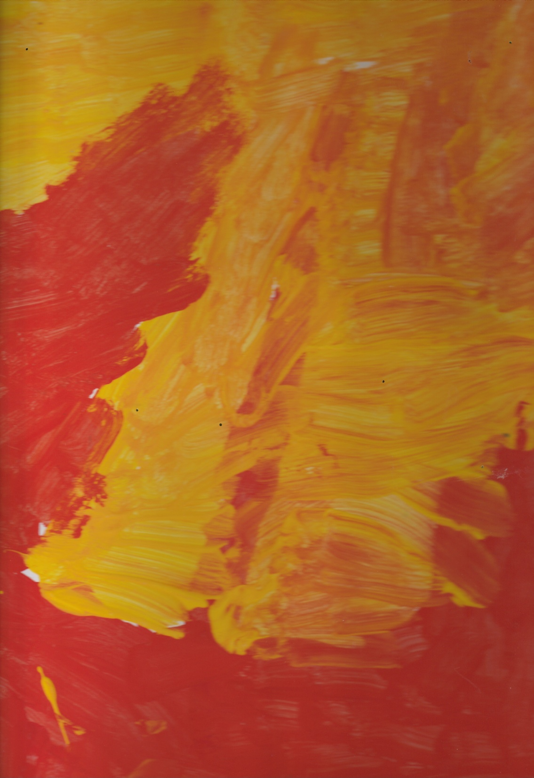
Sunshine Artwork

Slide 2
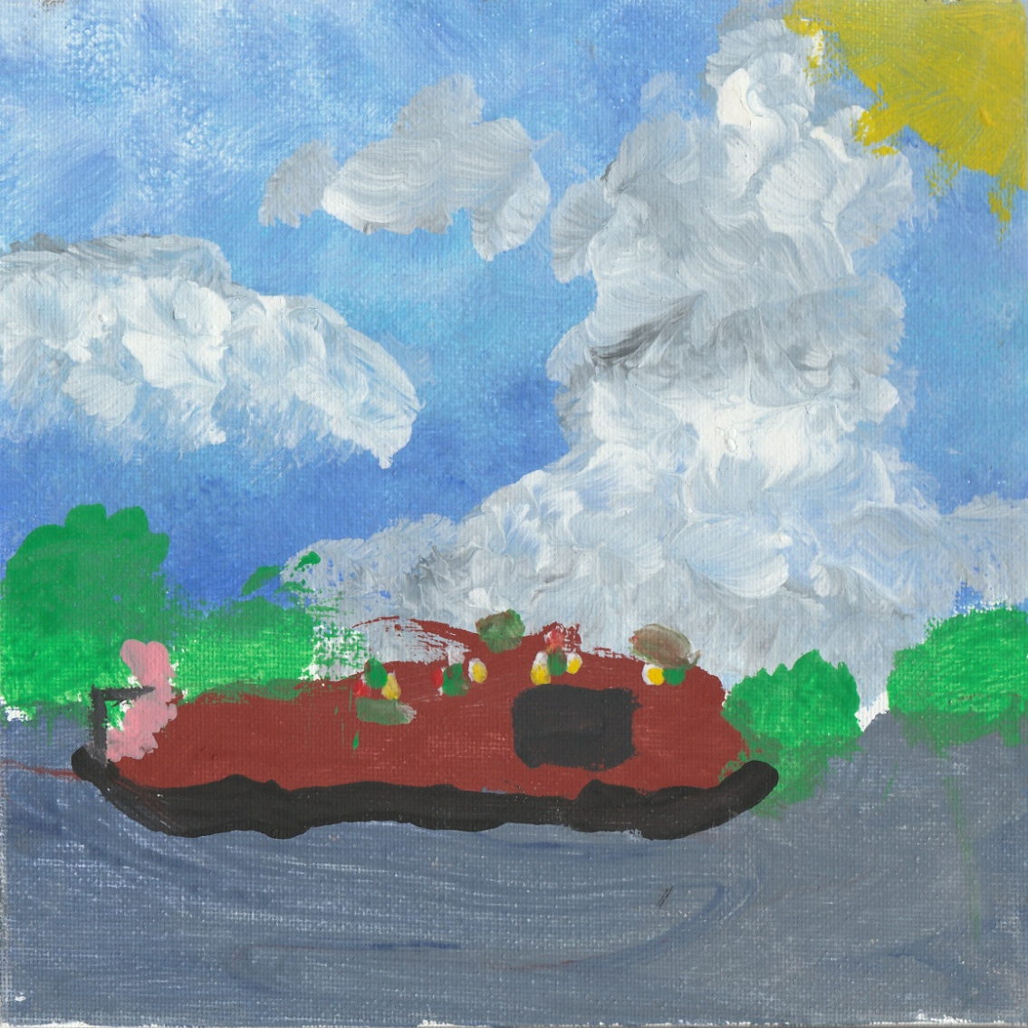
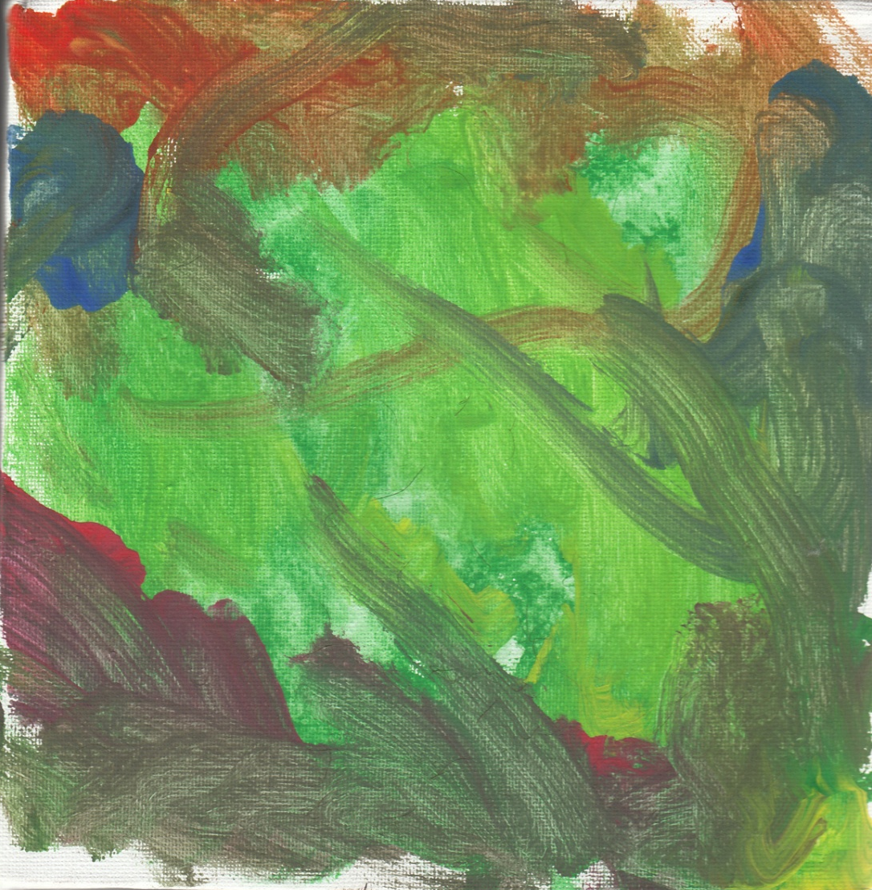
Alne Hall
Rachael G

Slide 3
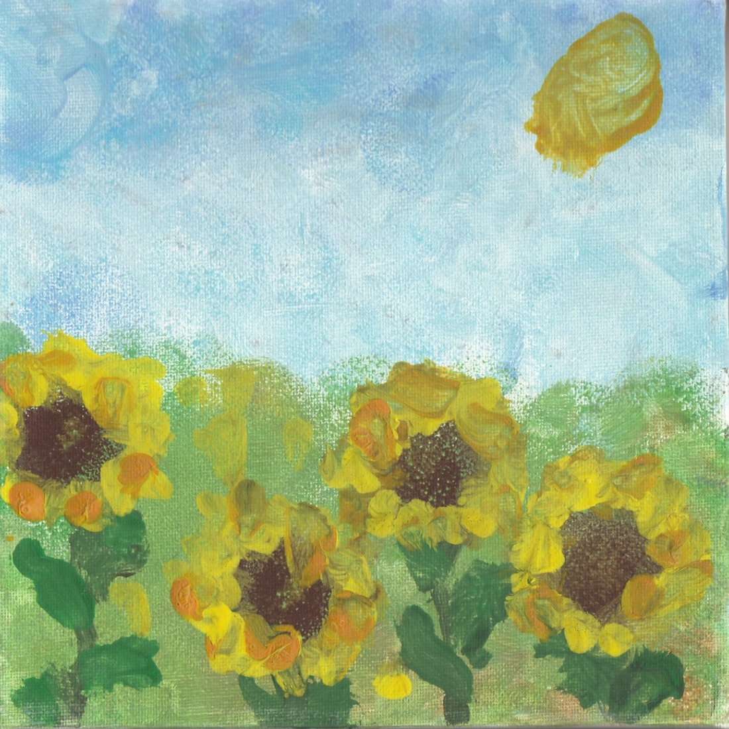
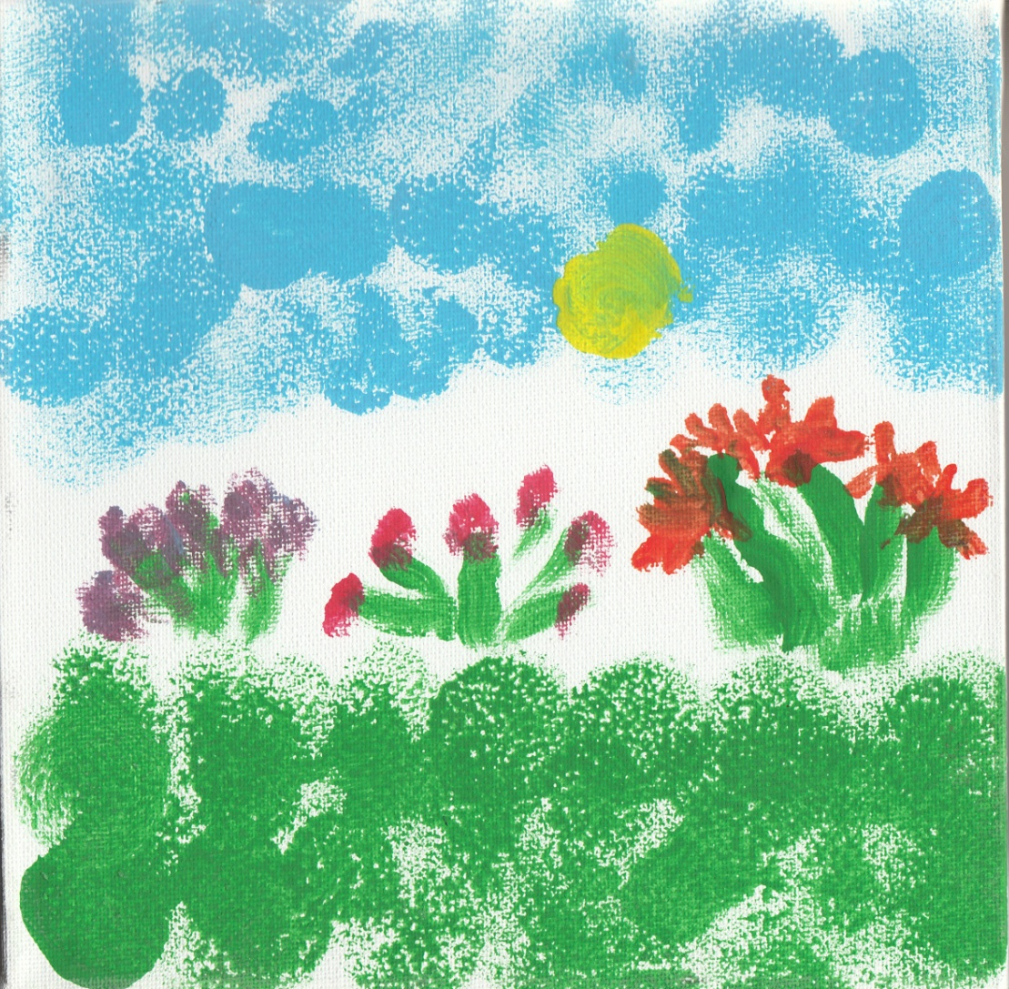
Phil N
Veronica

Slide 4
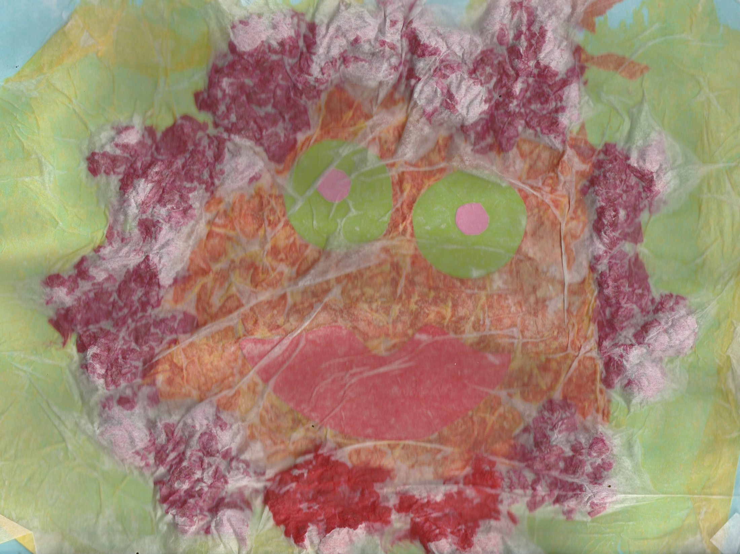
Hampton Resource Centre -Peterborough

Slide 5
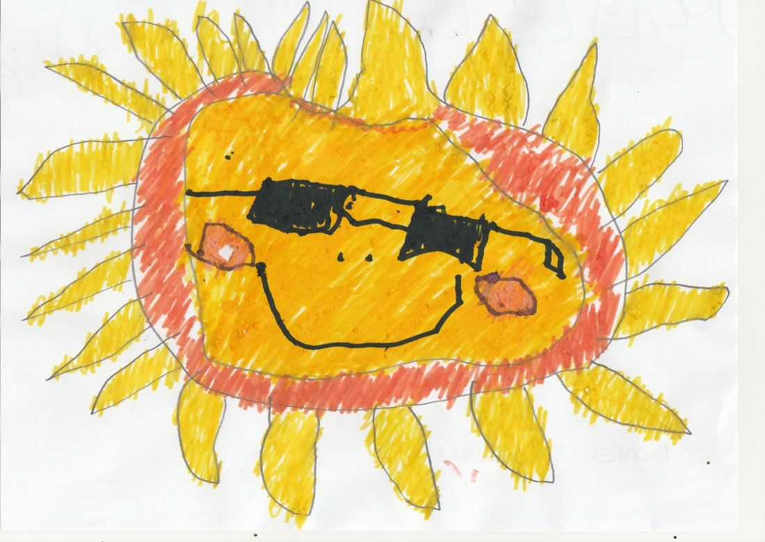
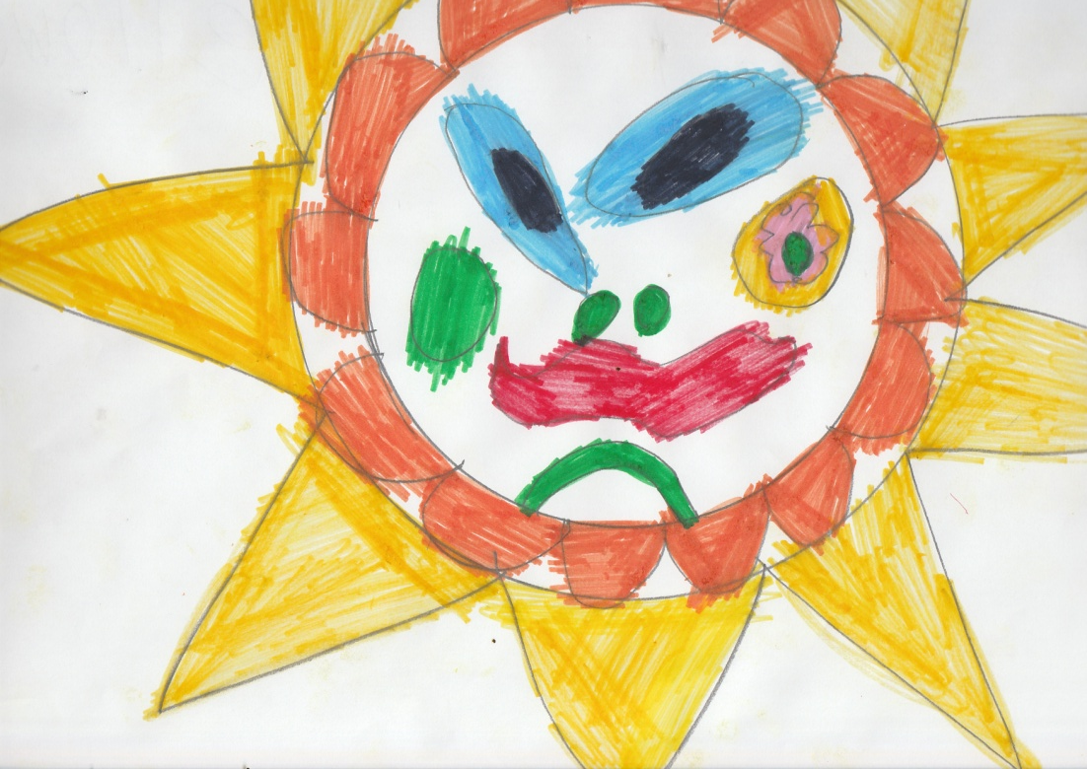
Jessica Bull
Daniel Treadwell
Gillian Fellows

Slide 6
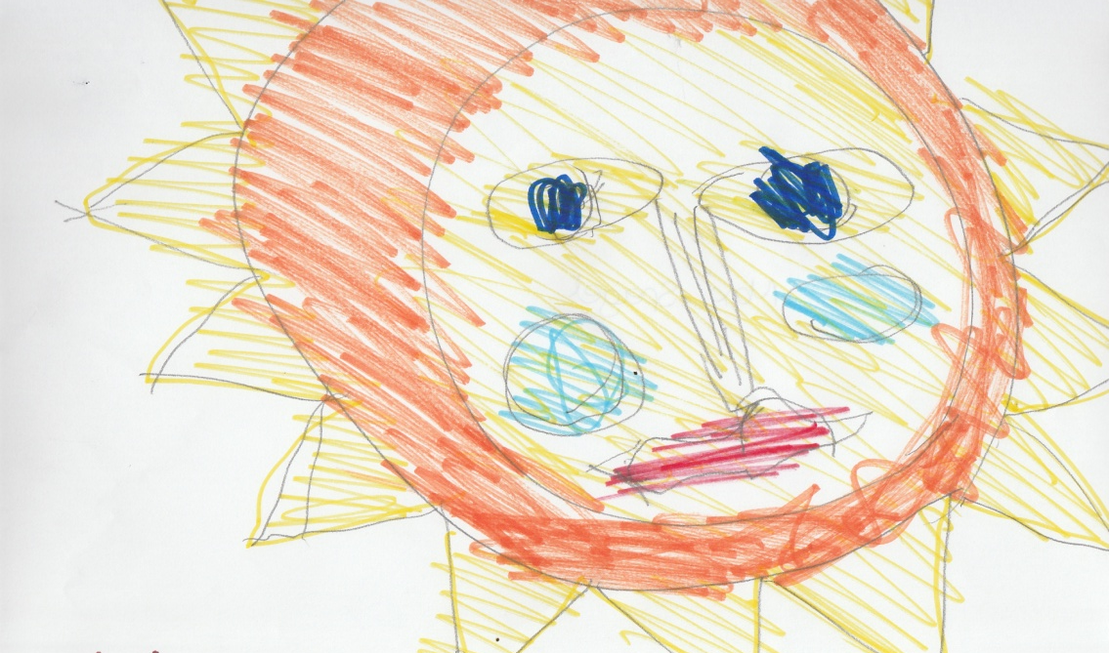
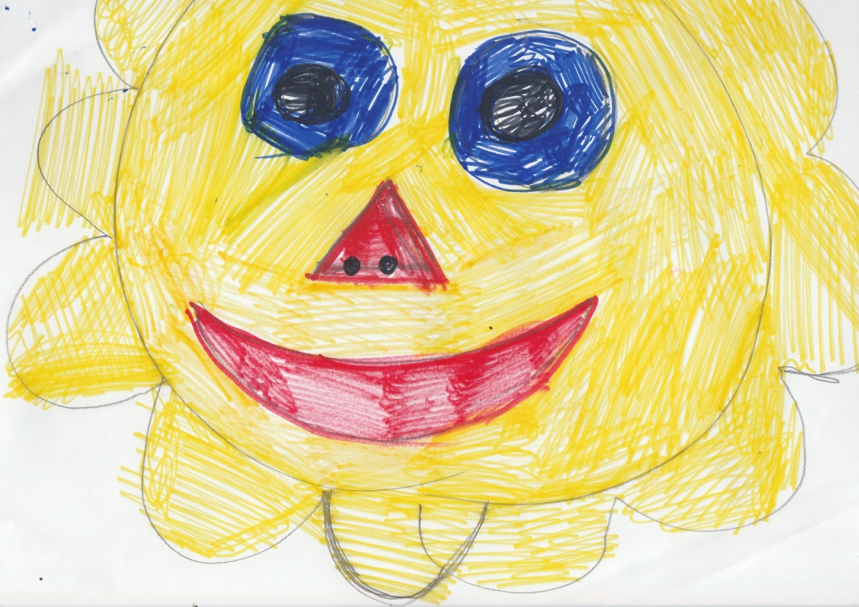
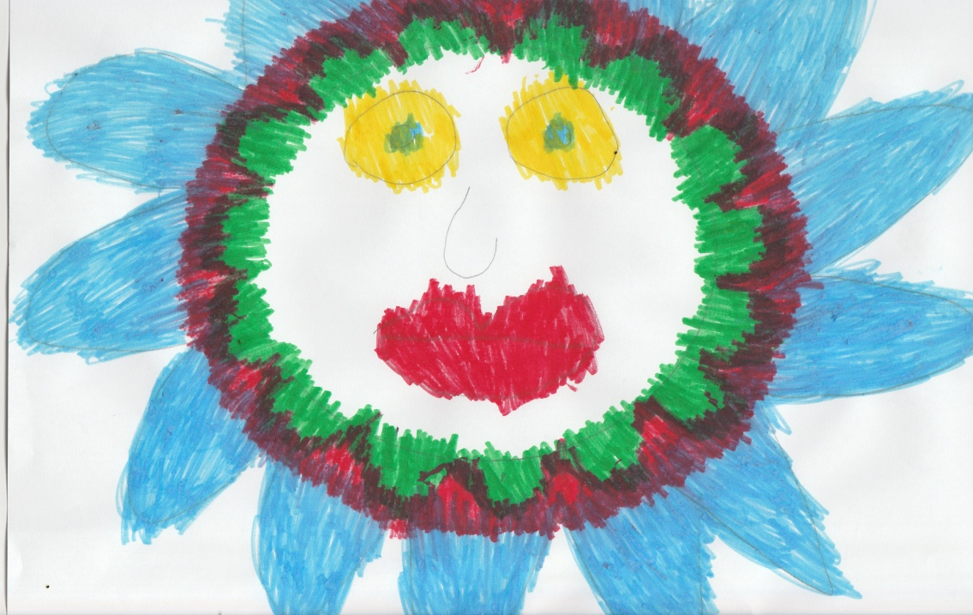
Max Speigel
Karen Goldsack
Amanda Armitage

Slide 7
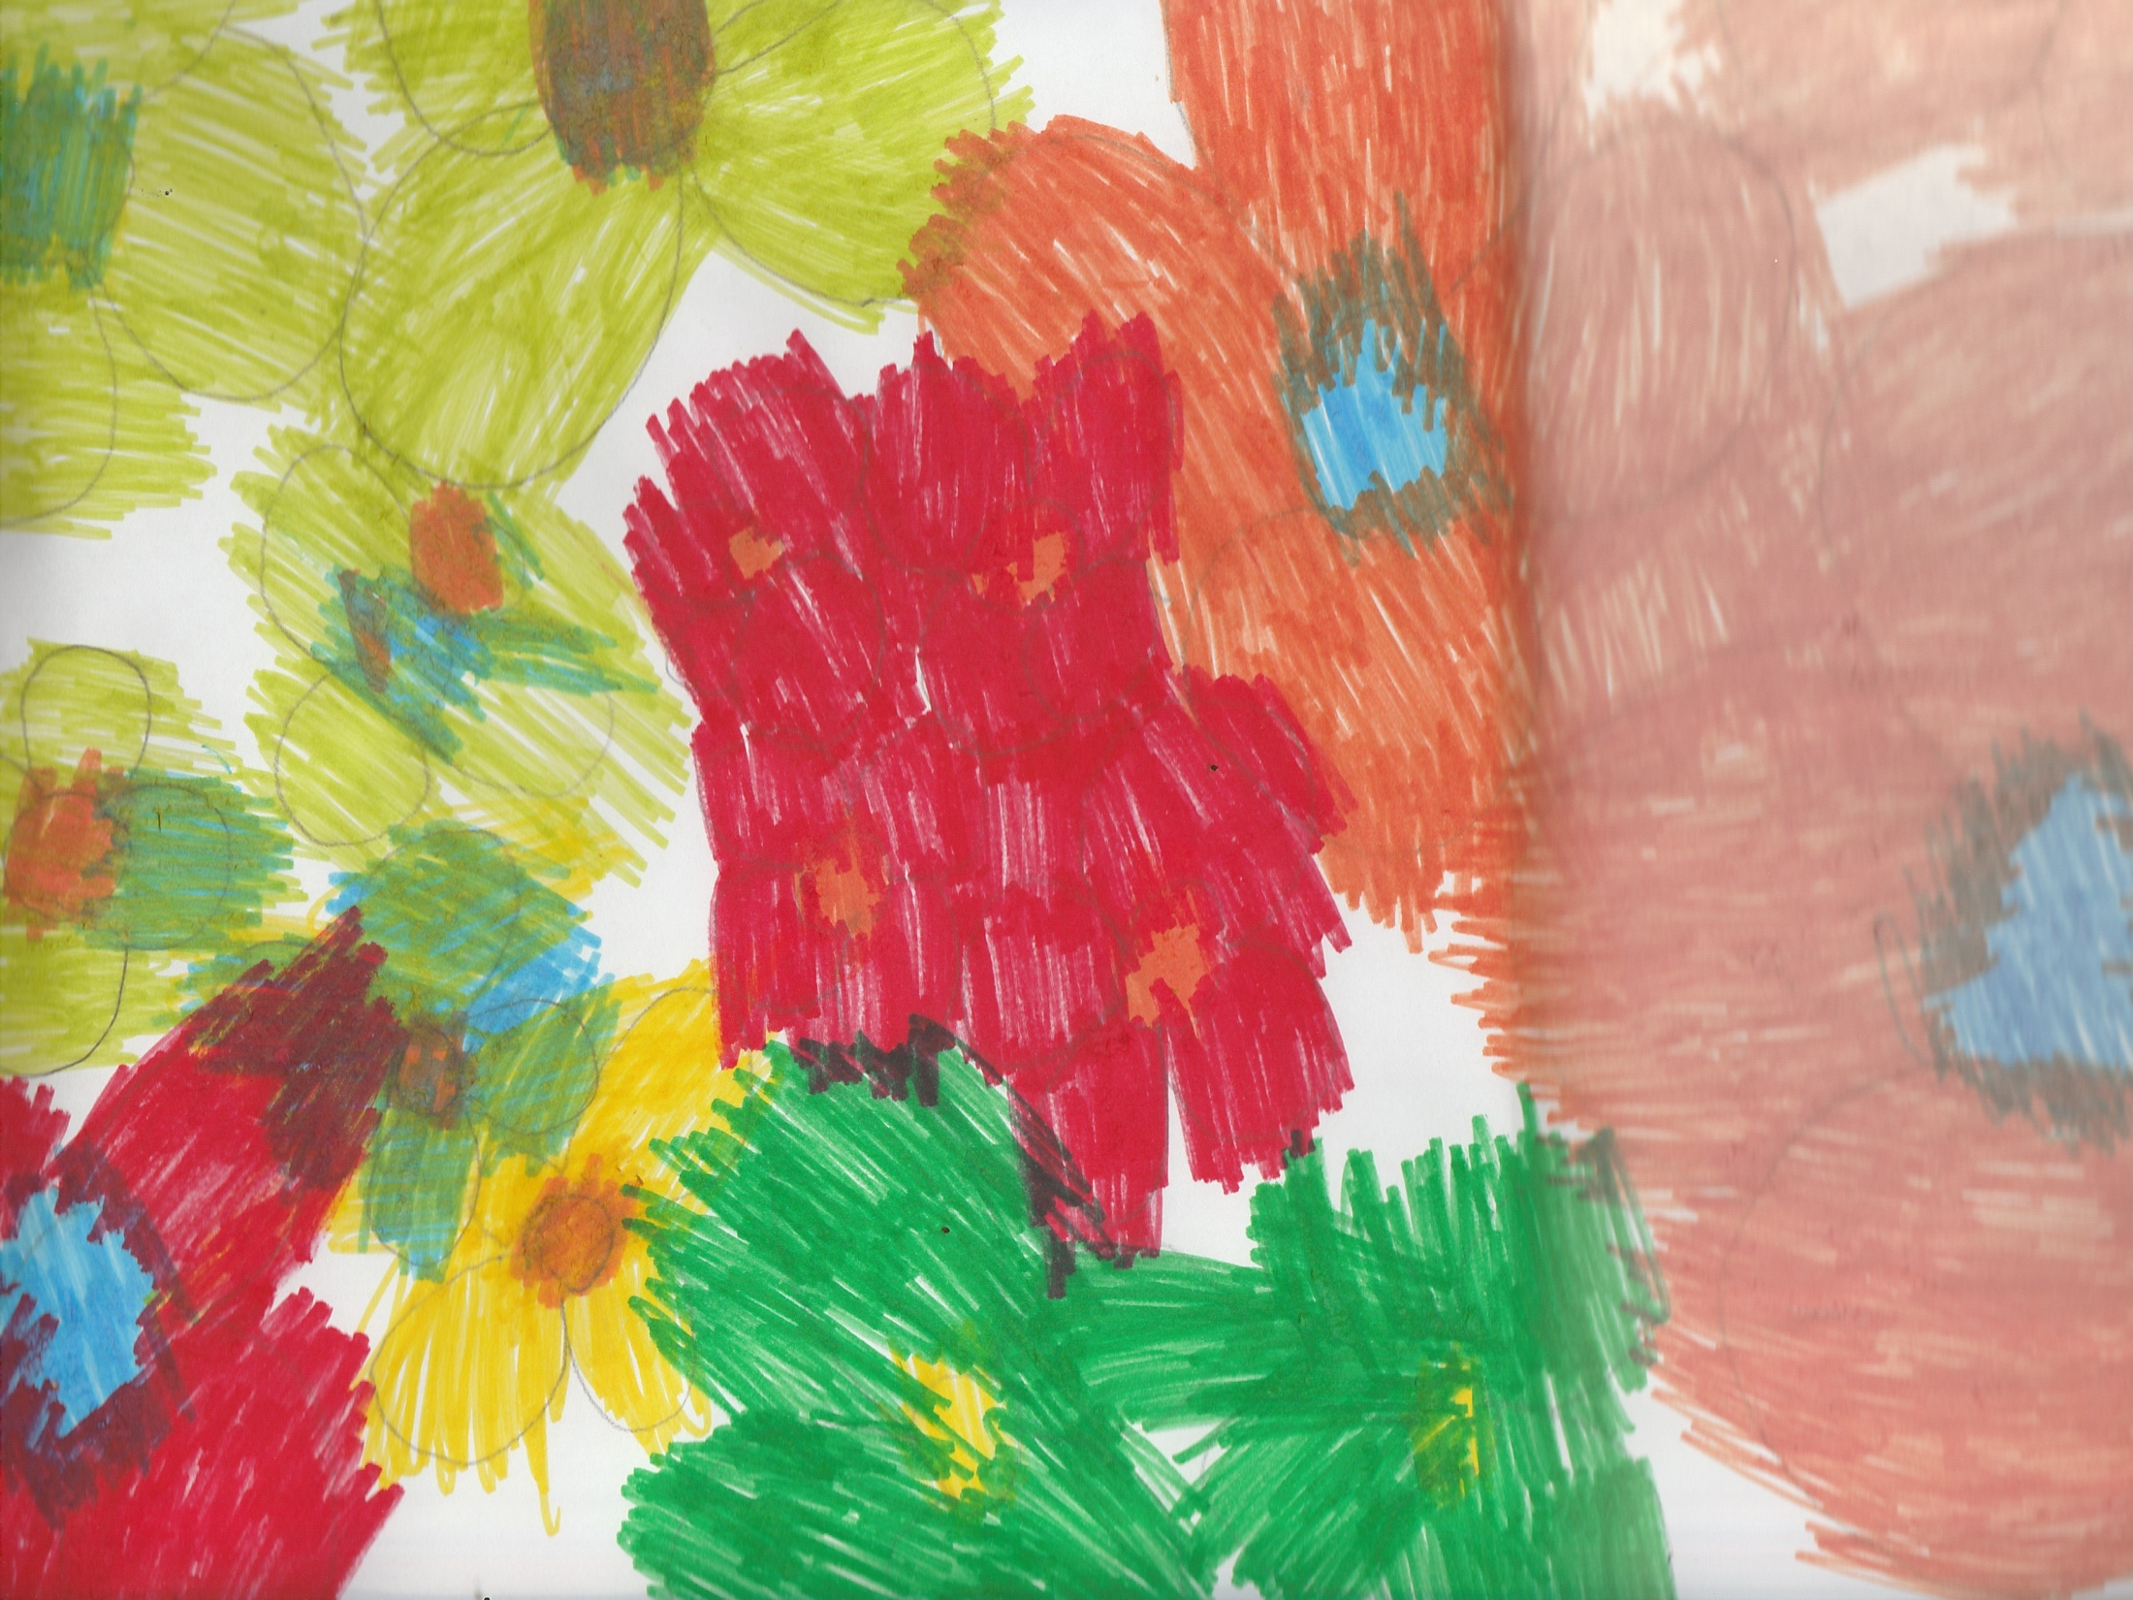
Amanda Armitage

Slide 8
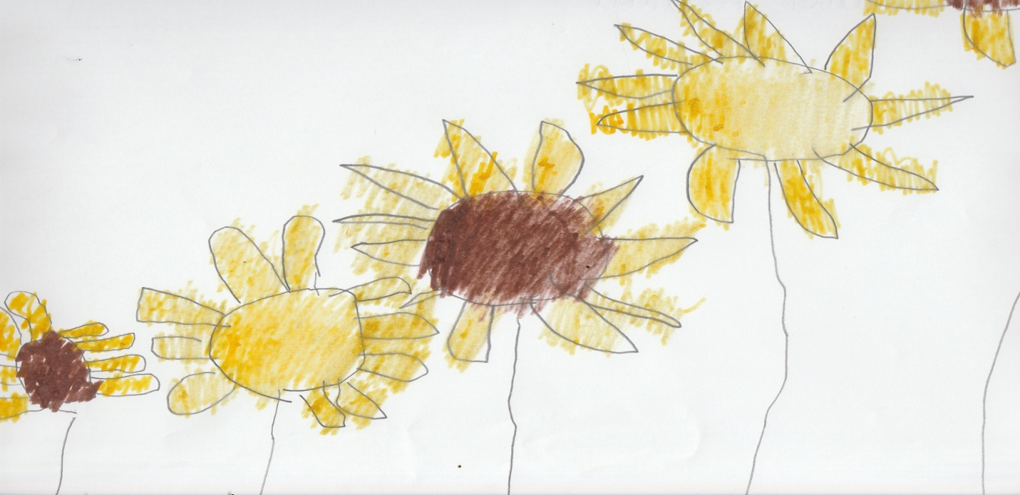
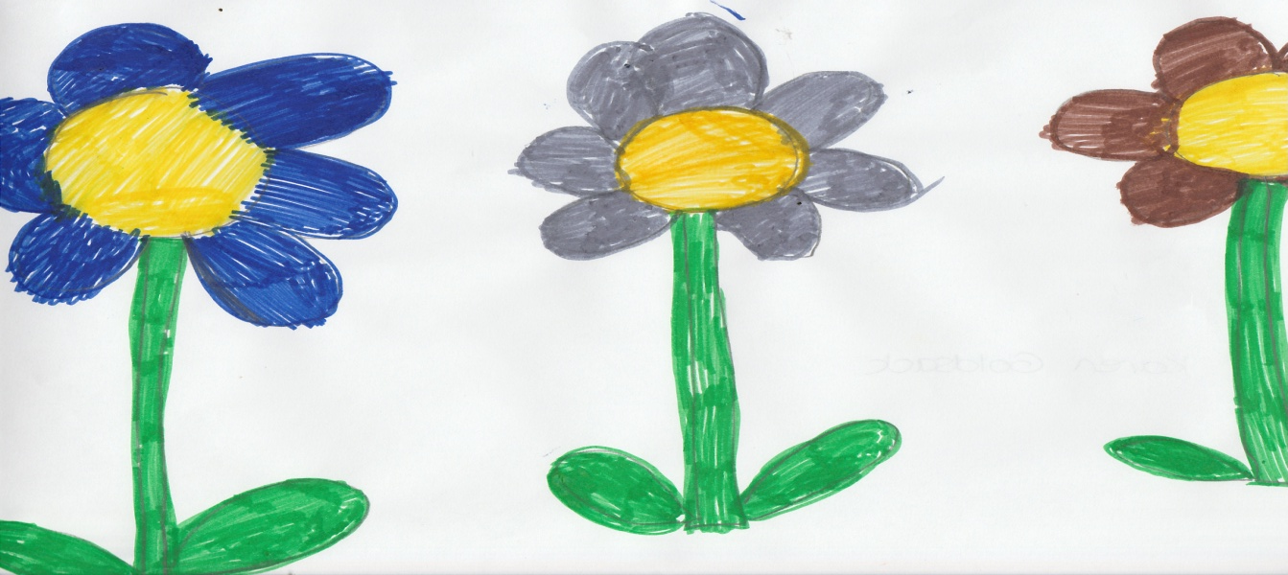
Daniel Treadwell
Max Speigel
Karen Goldsack

Slide 9
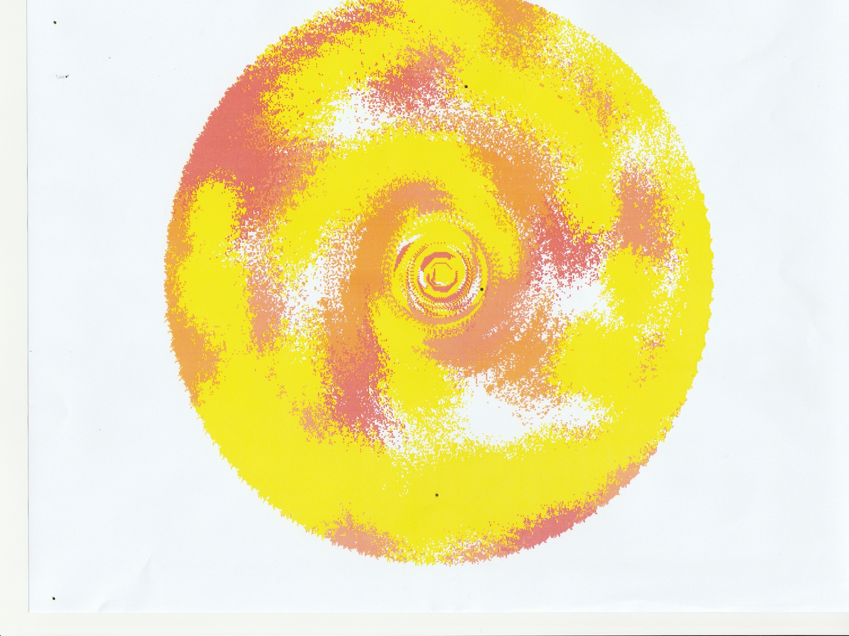
John Jamieson School:- Charlie Gibbons

Slide 10
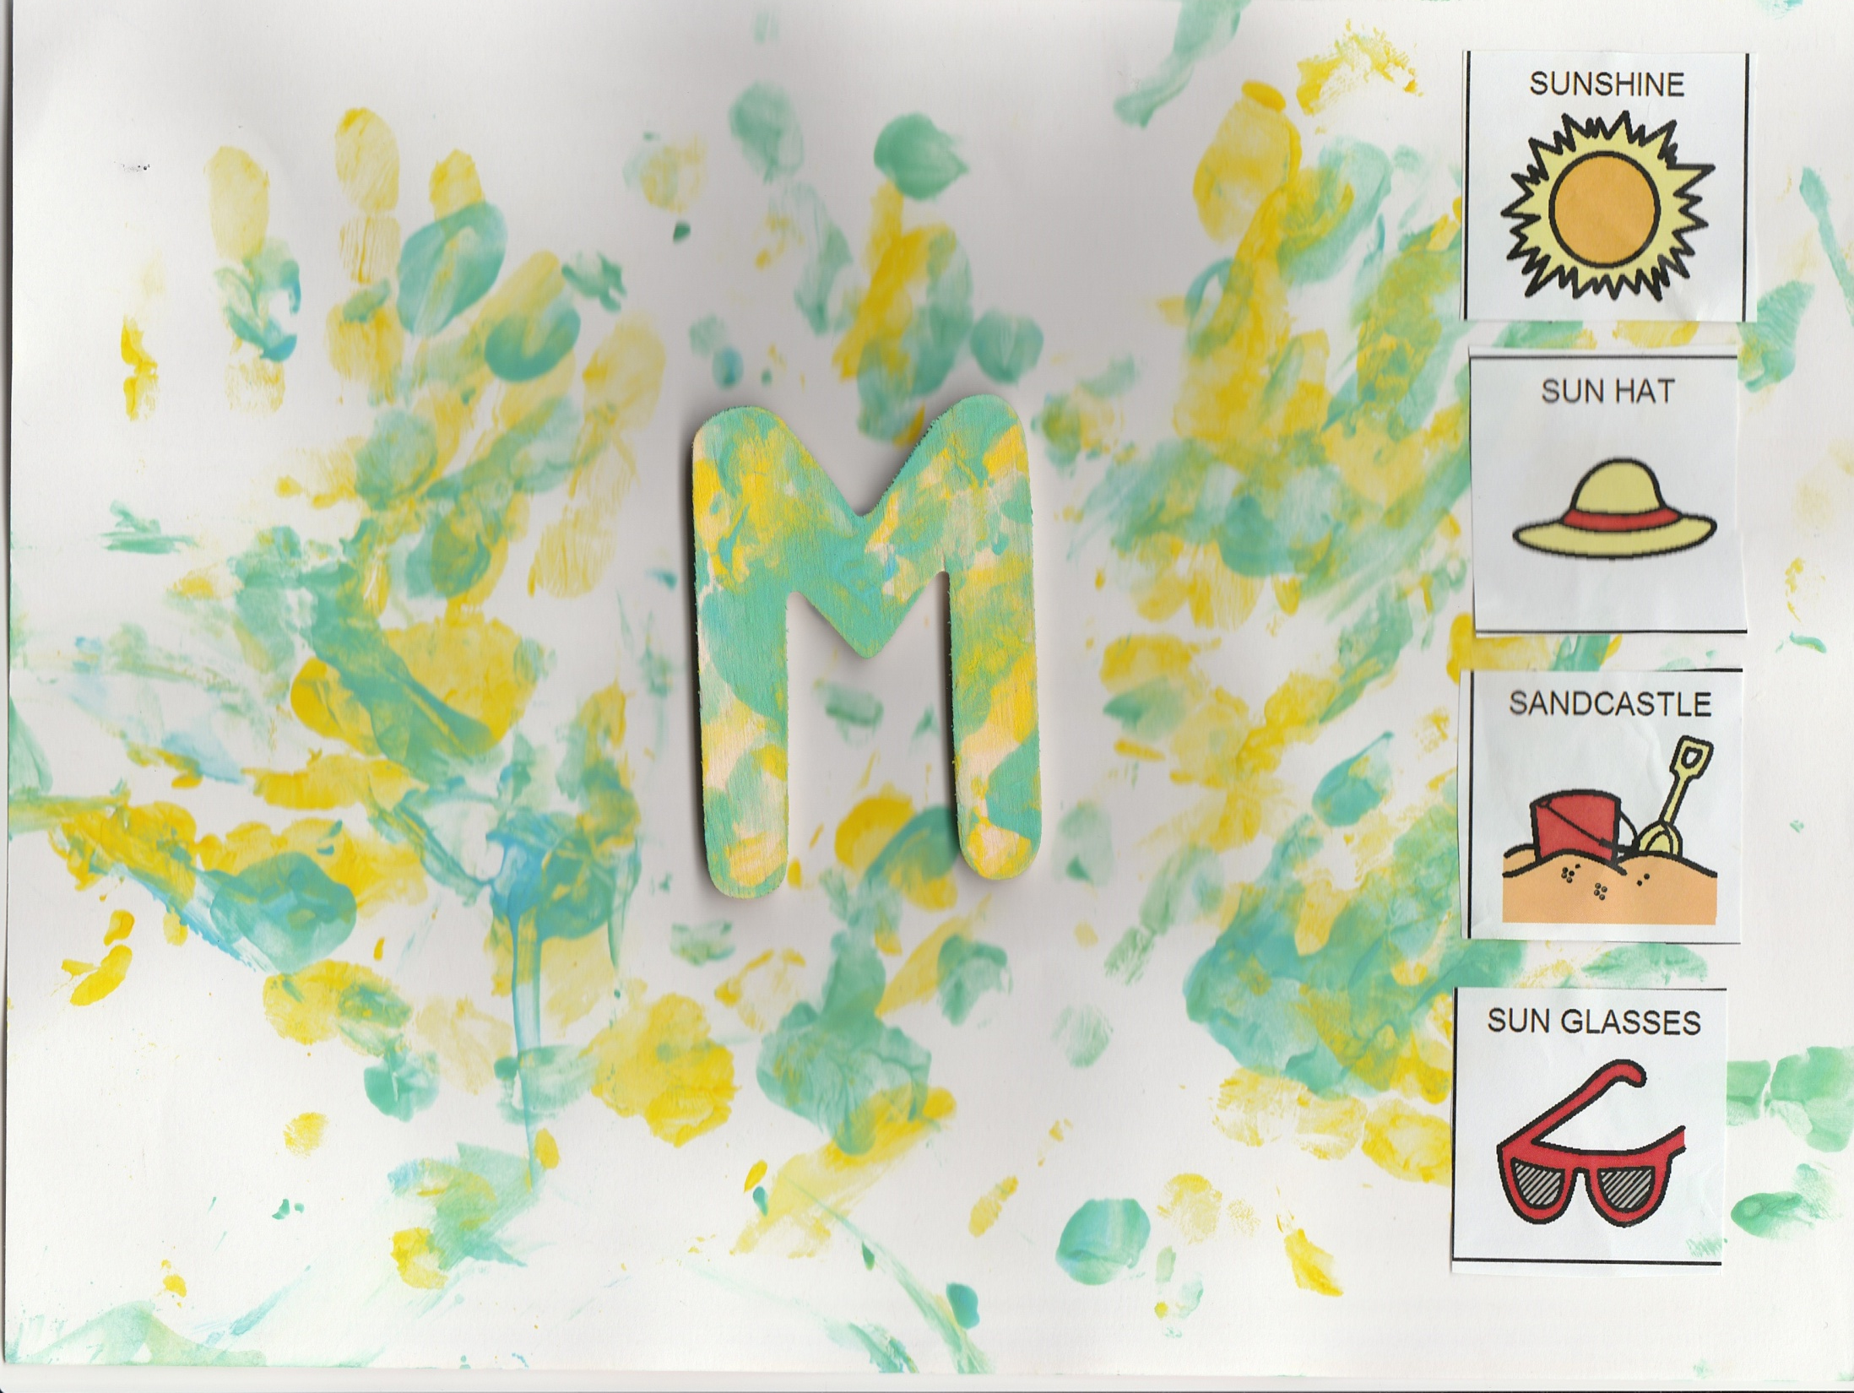
Irelandwood Primary School
Maisie

Slide 11
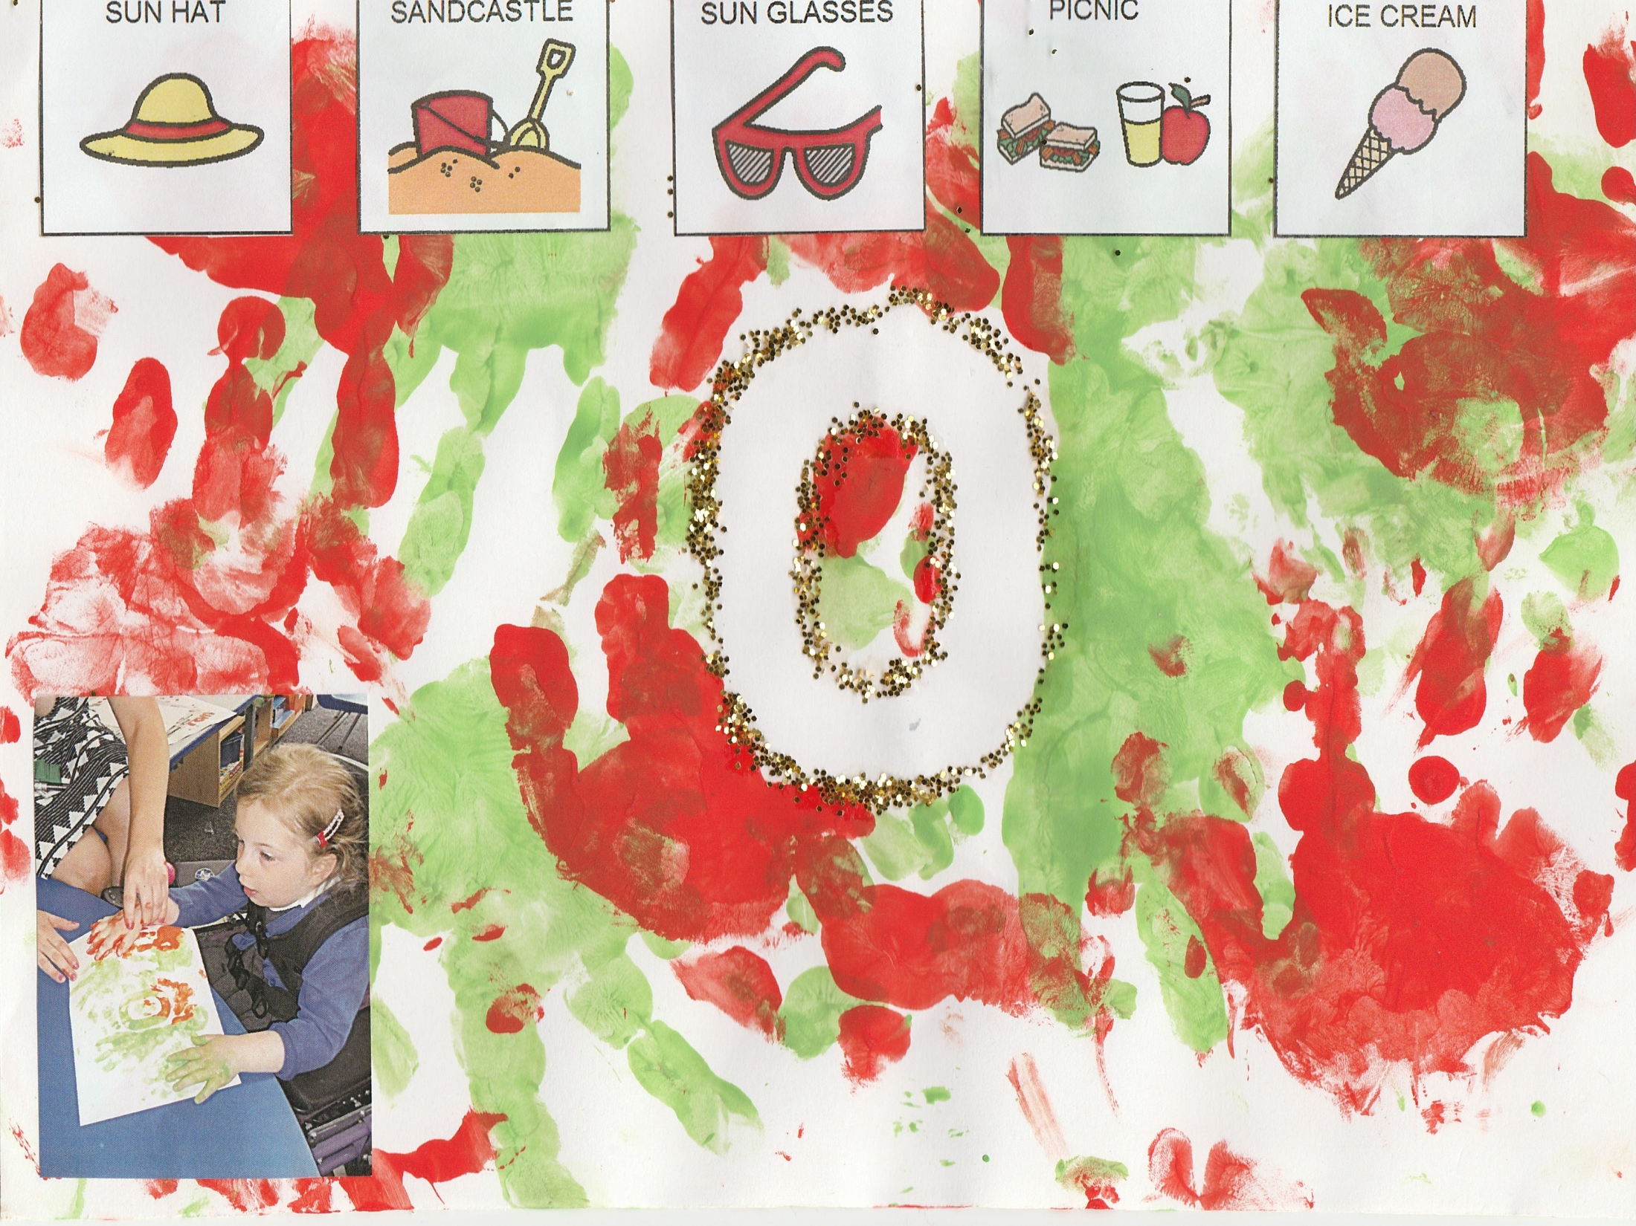
Olivia

Slide 12
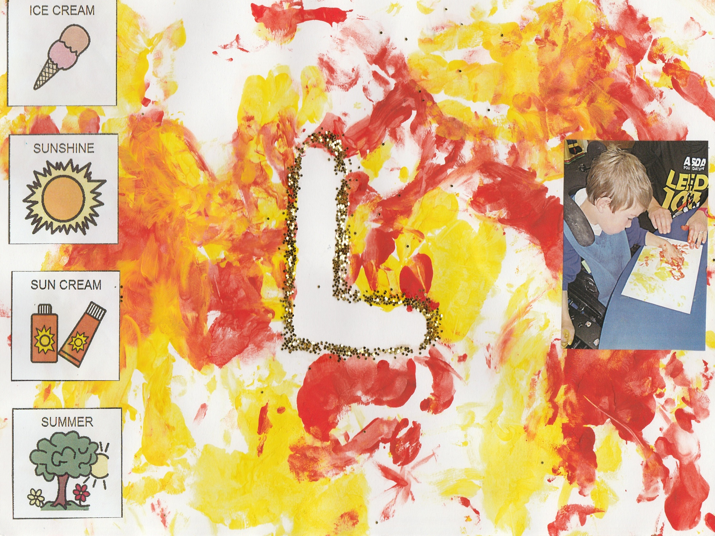
Lewis

Slide 13
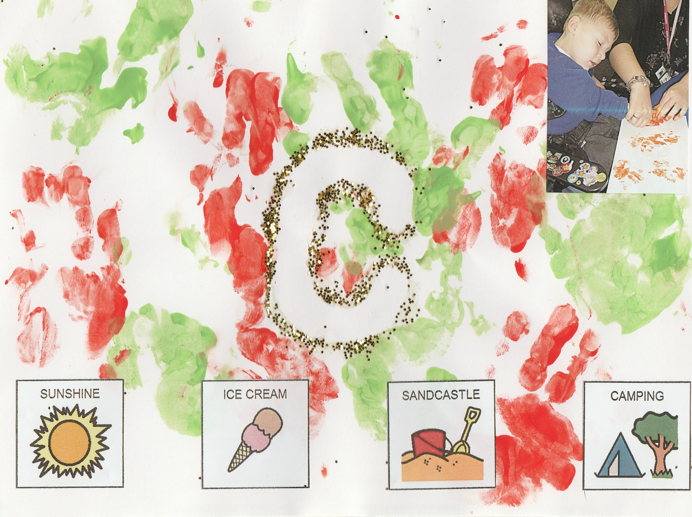
Kayden

Slide 14
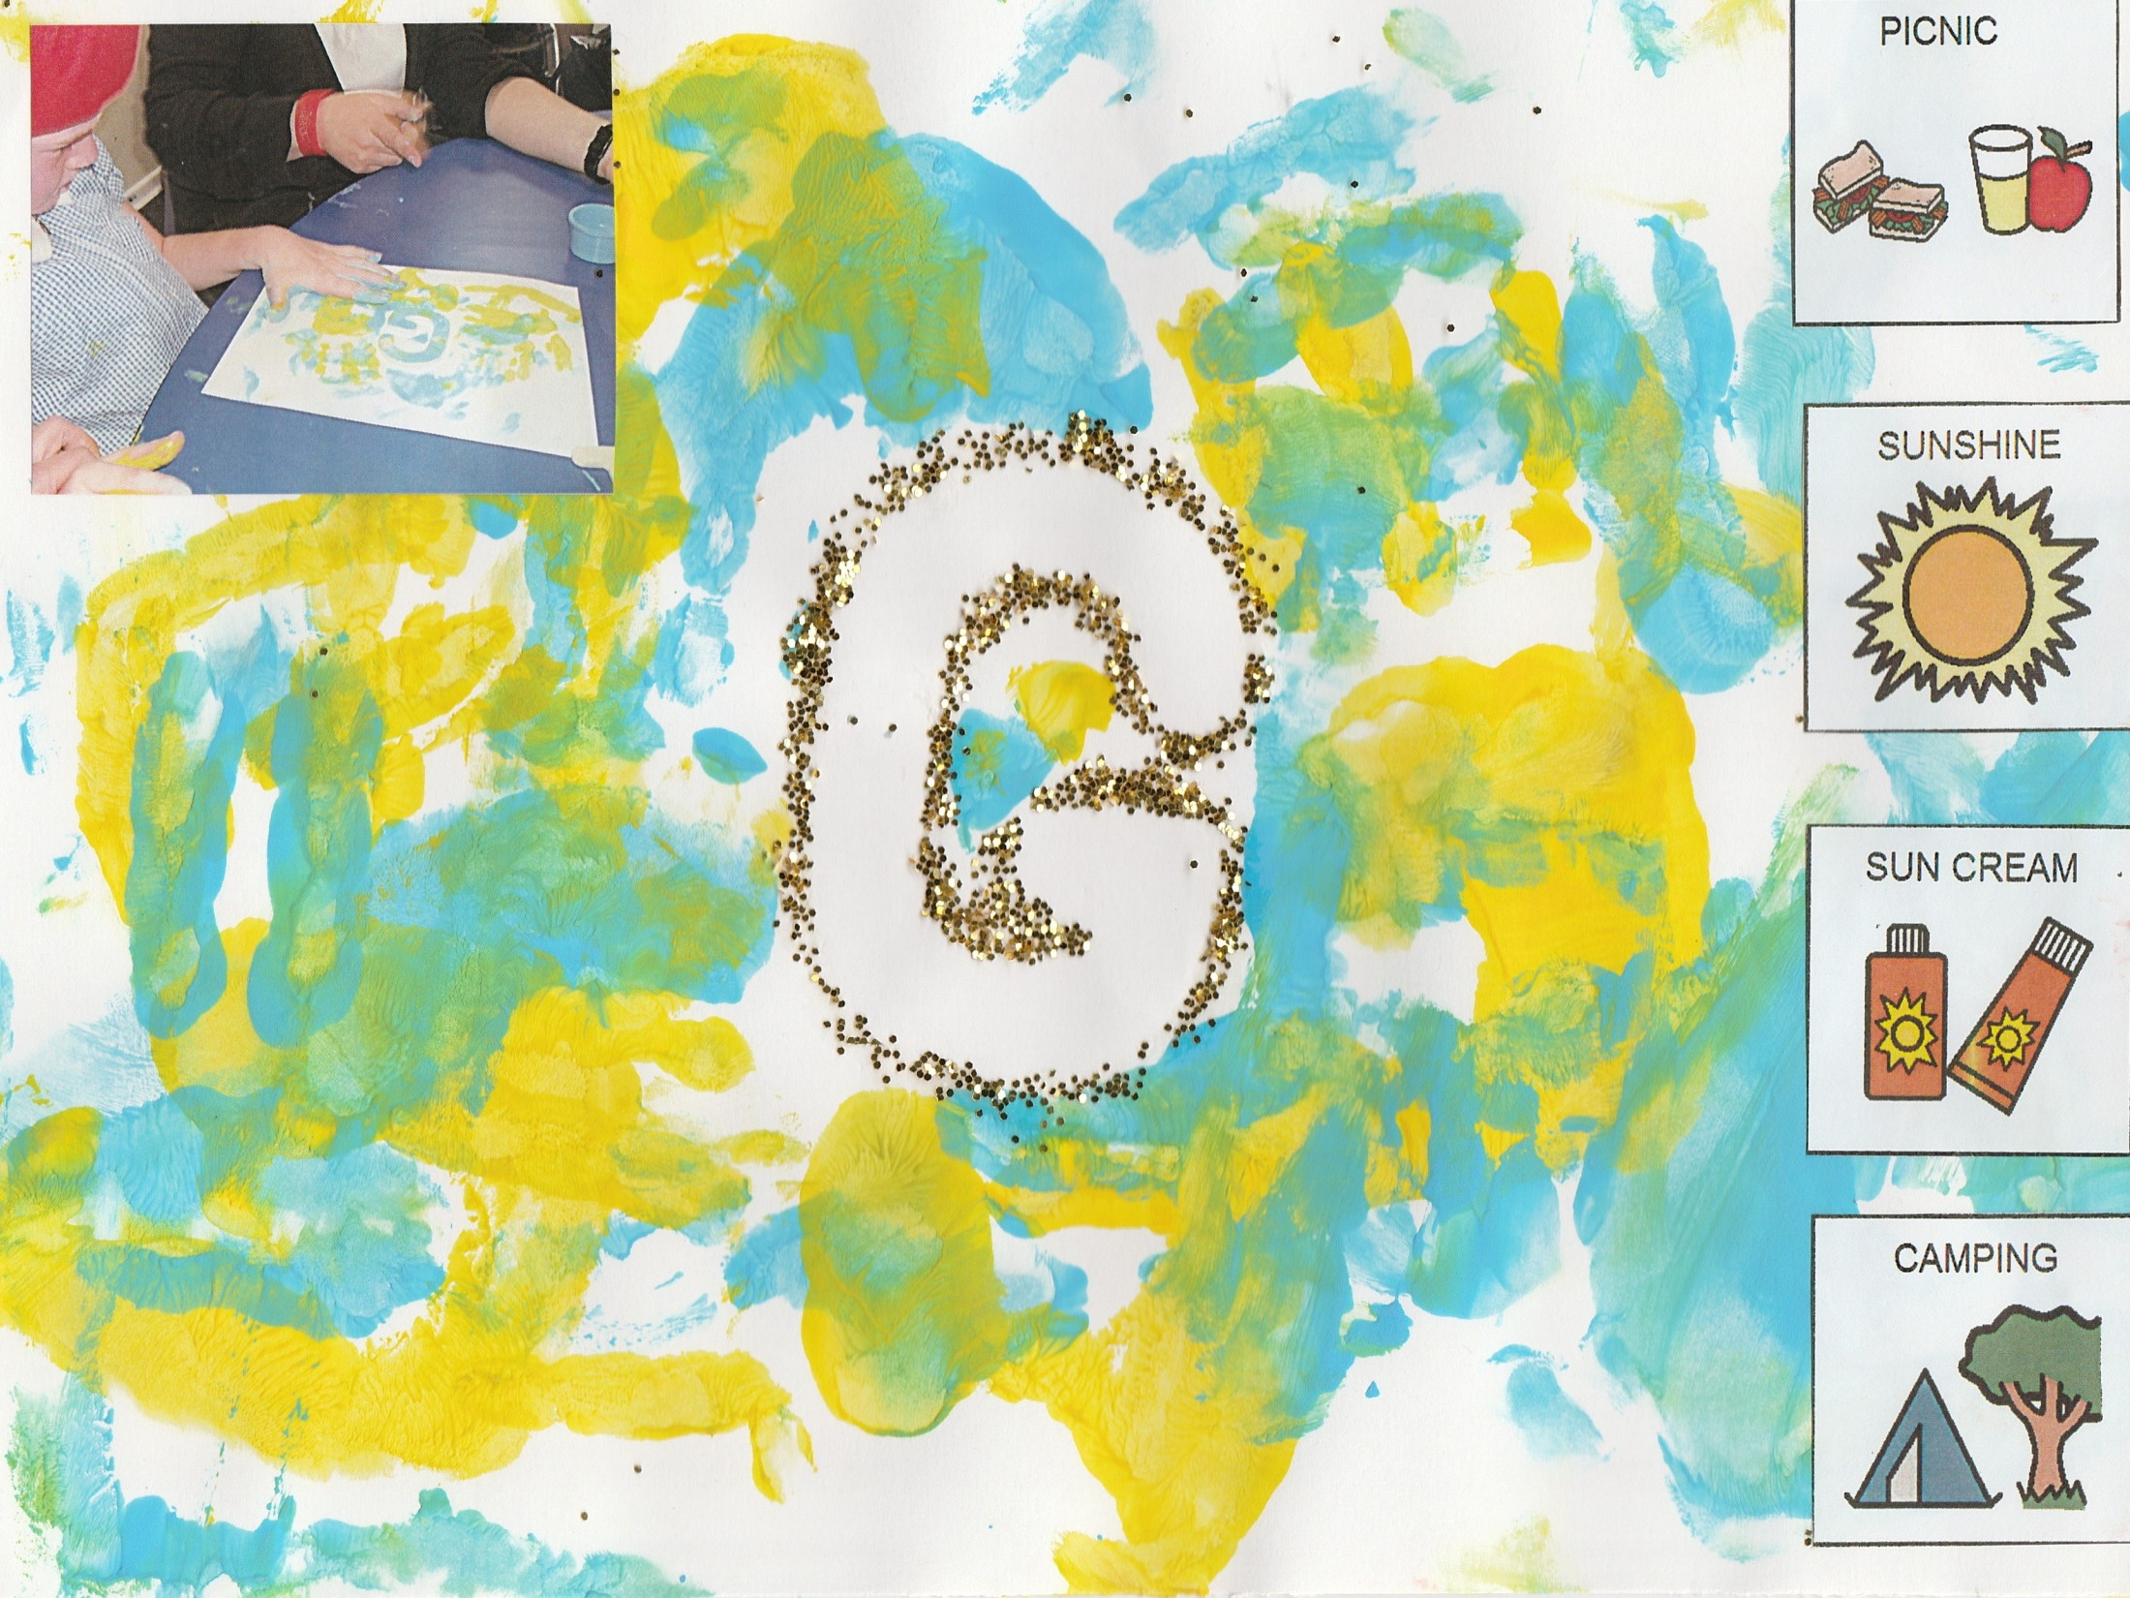
Georgia

Slide 15
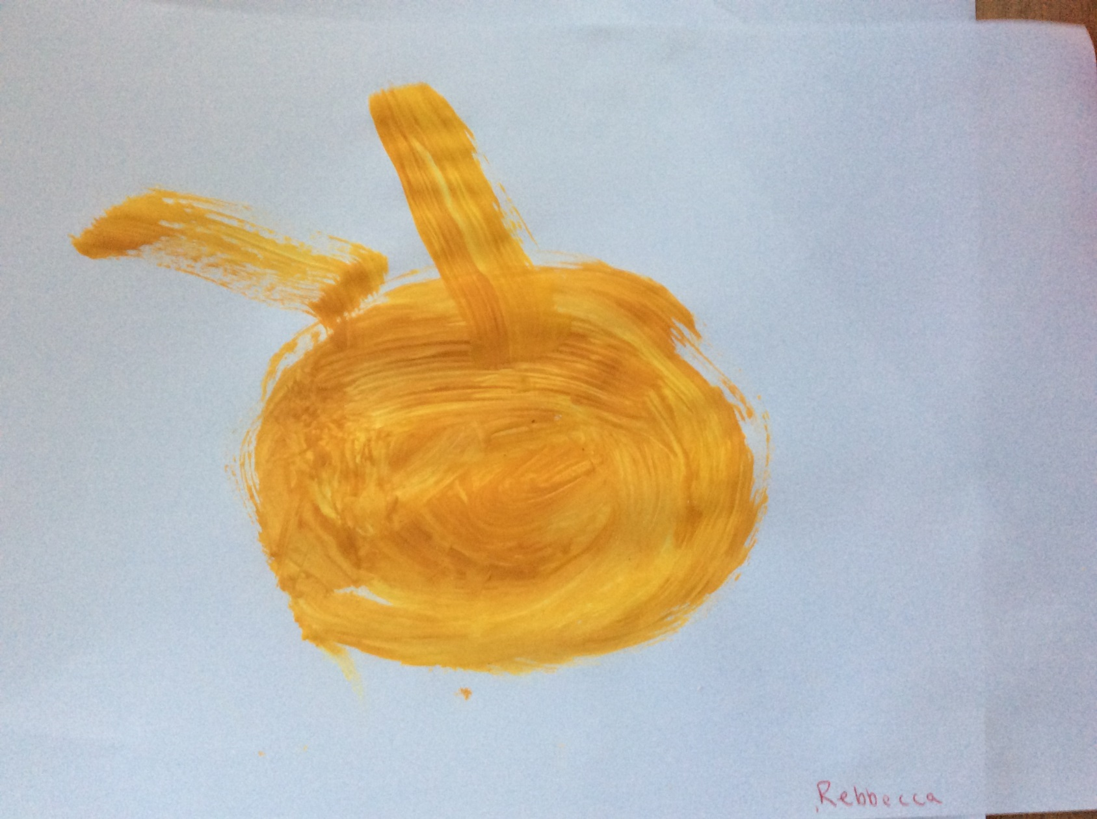
Chestnut Lodge School
Rebecca Penney, aged 6

Slide 16
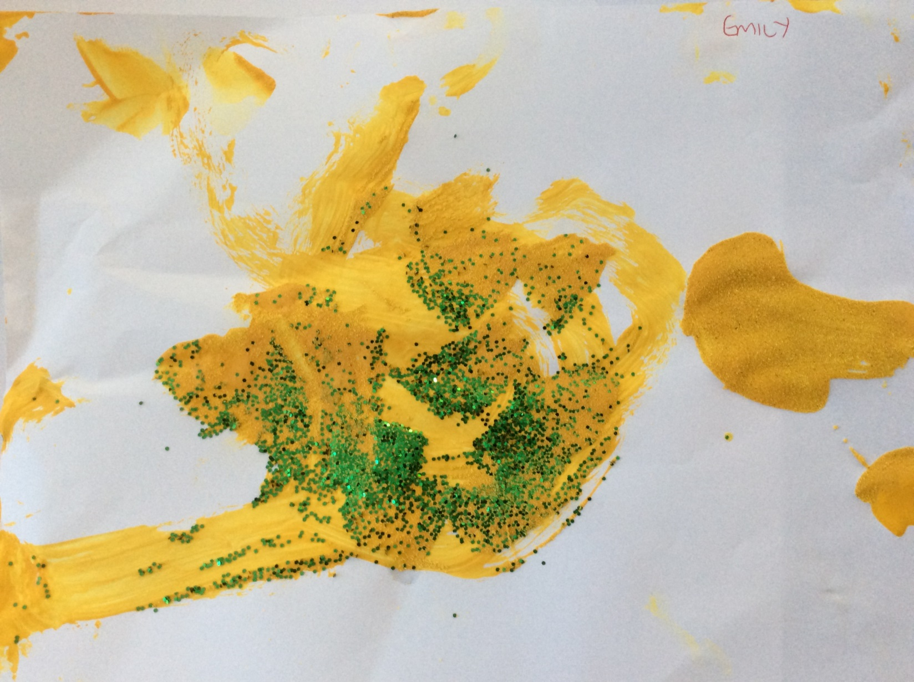
Emily Tedds, aged 13

Slide 17
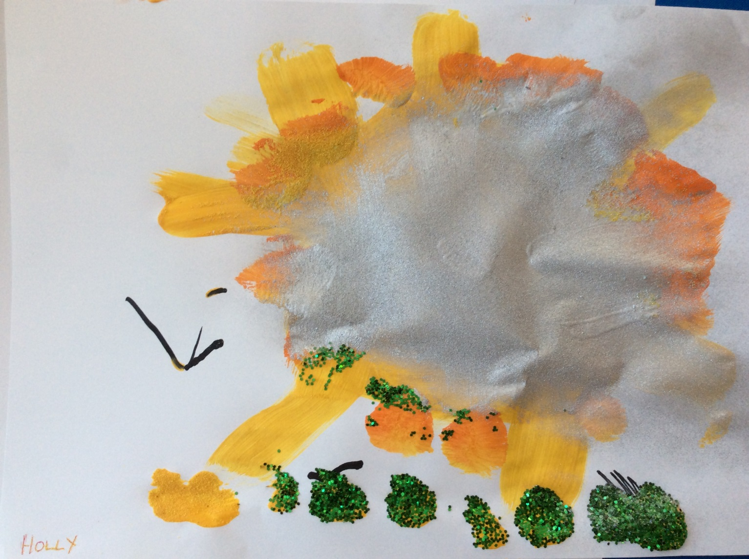
Holly McKitrik, aged 9

Slide 18
St Teresa’s LCD, Penzance:-
Sylvie Emmerson
Hillside School

Slide 19
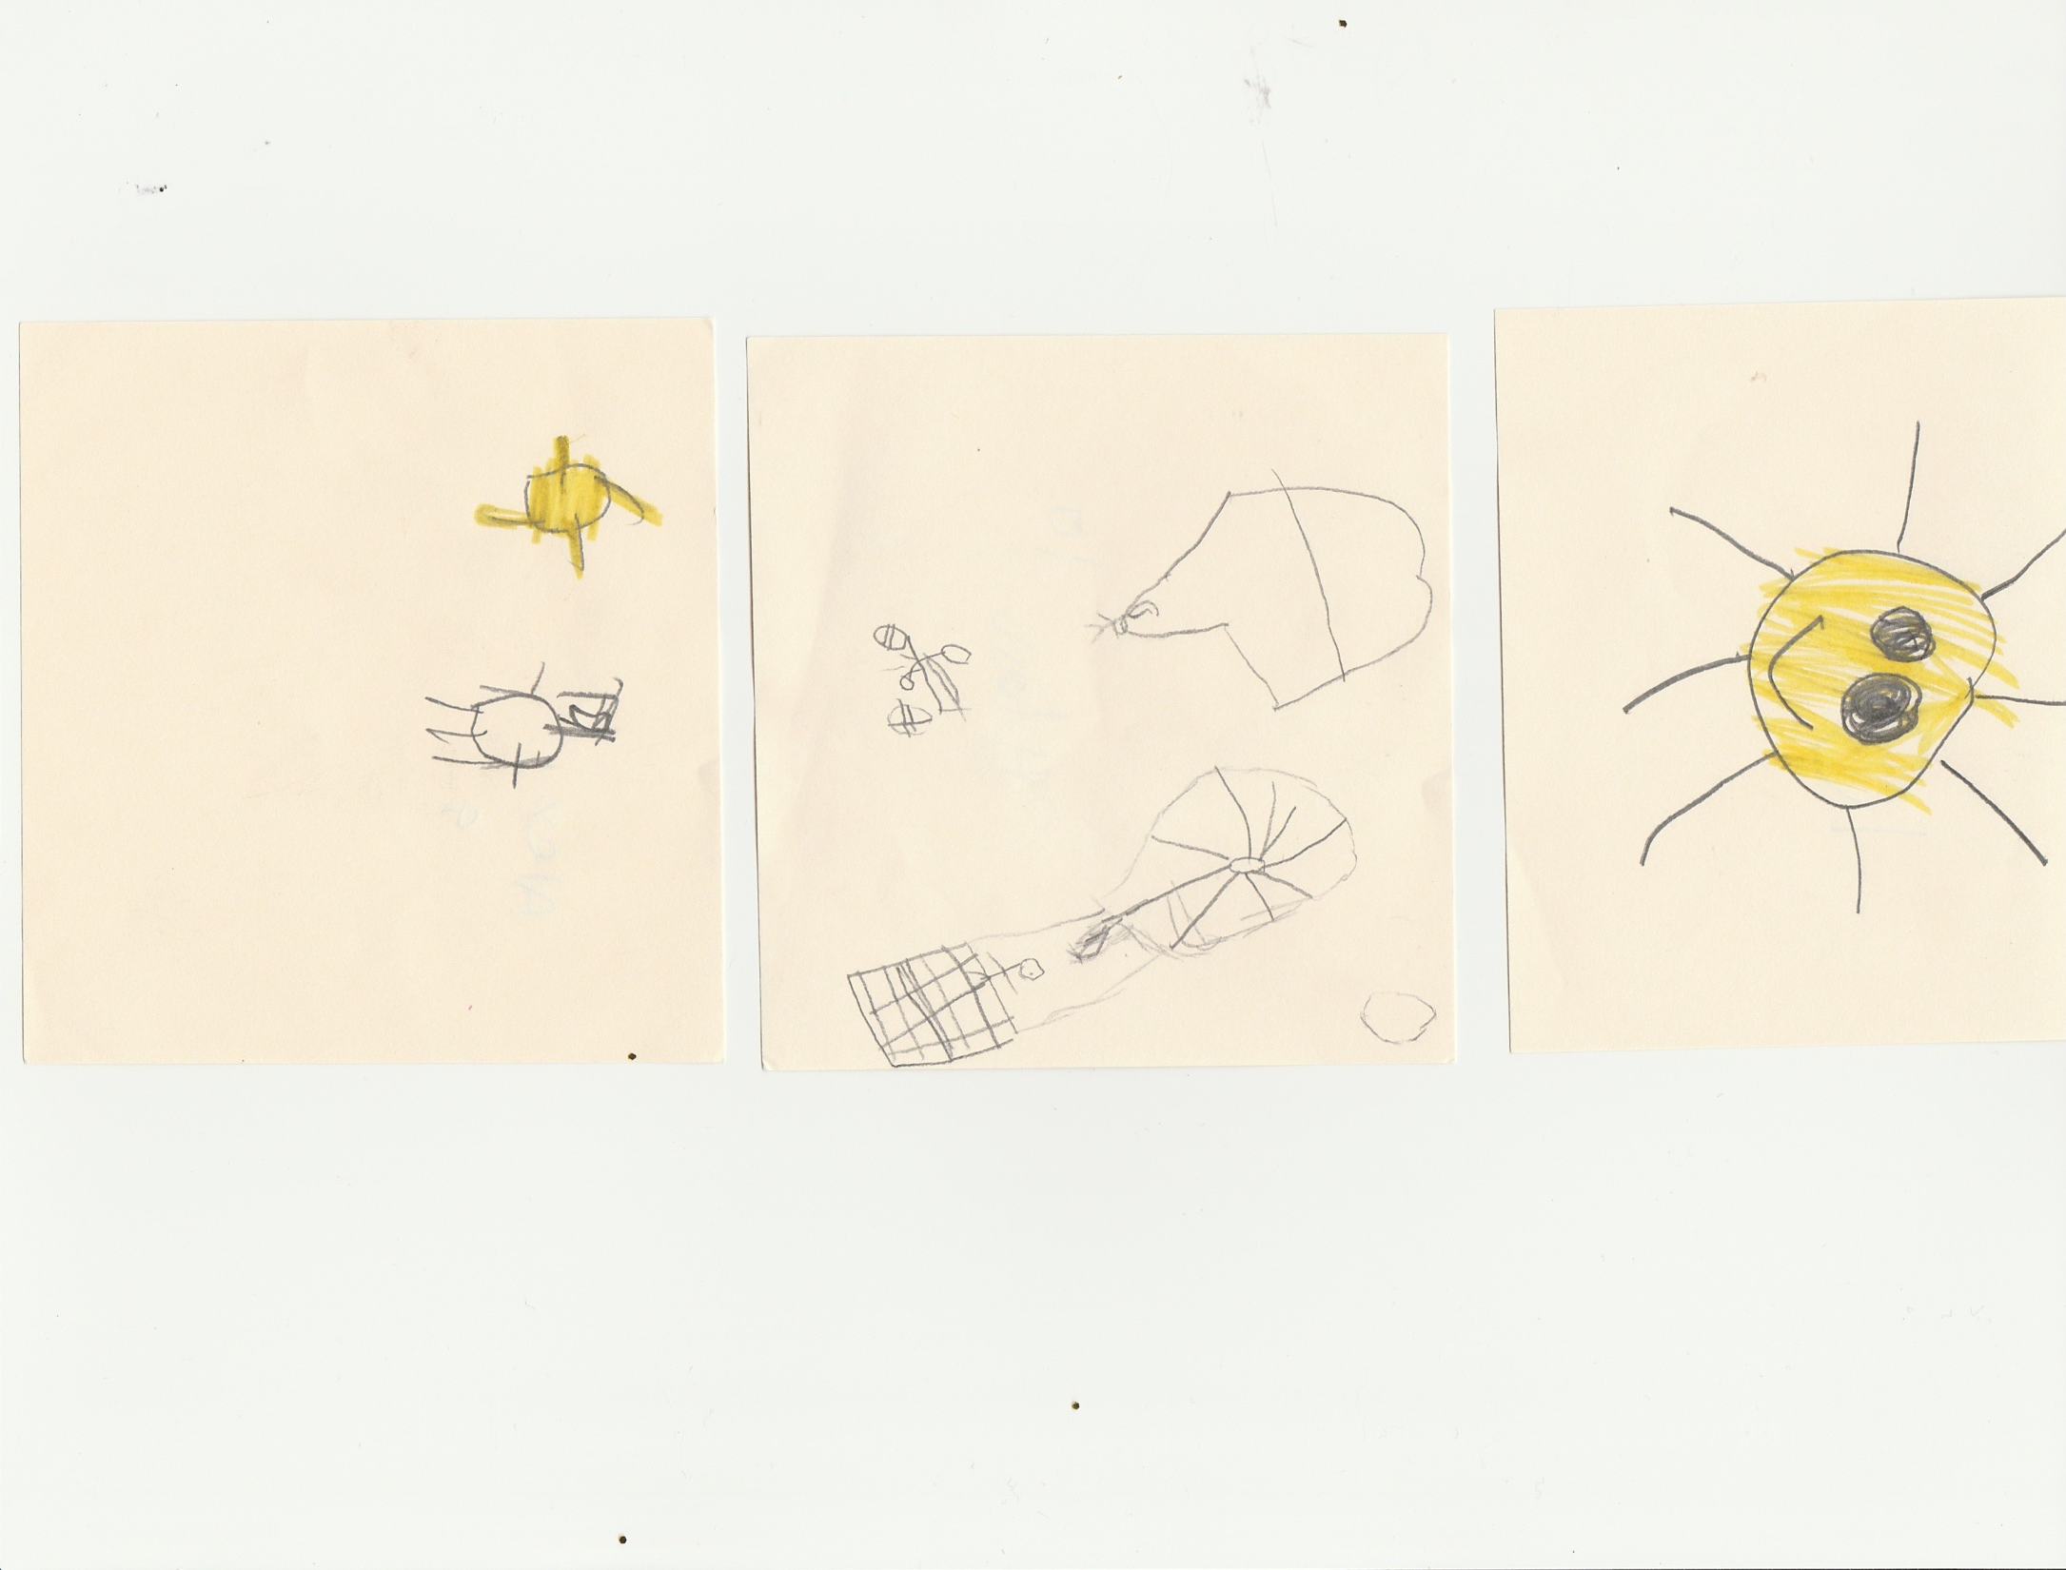
Alex, 9
Dylan, 10
Paige, 10
Marshlands School

Slide 20
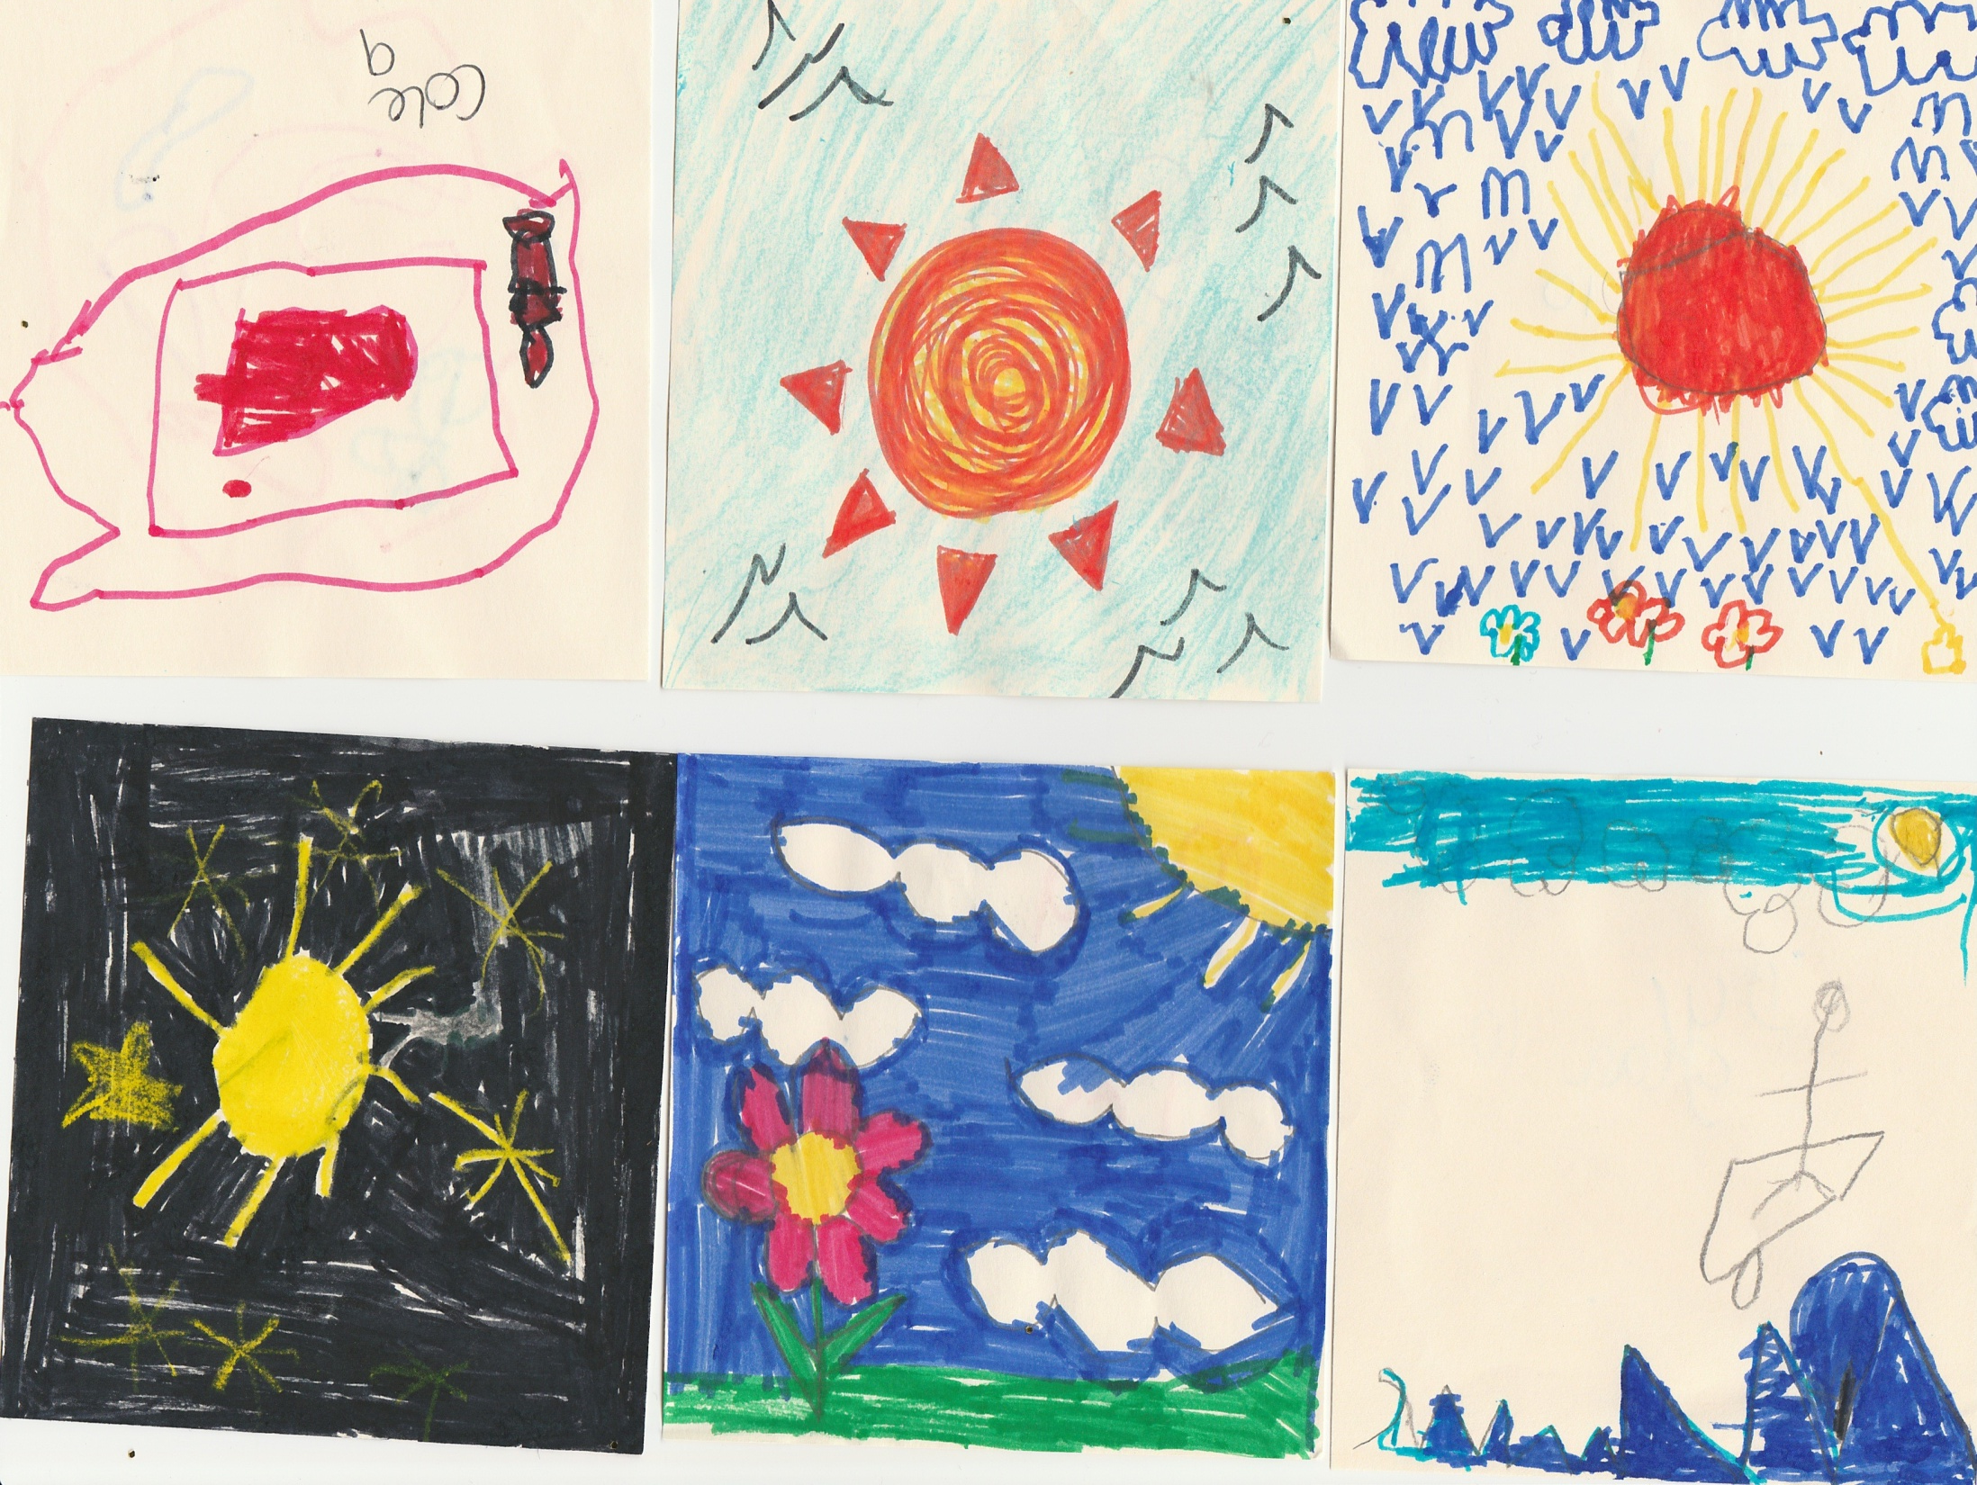
Cole, 9
Cam, 10
Daniel, 10
Mark, 7
Meg, 10
Dylan, 10

Slide 21
Ejovi Onobrauche and Paula Curtis Athol House (Leonard Cheshire) with Mary Israel

Slide 22
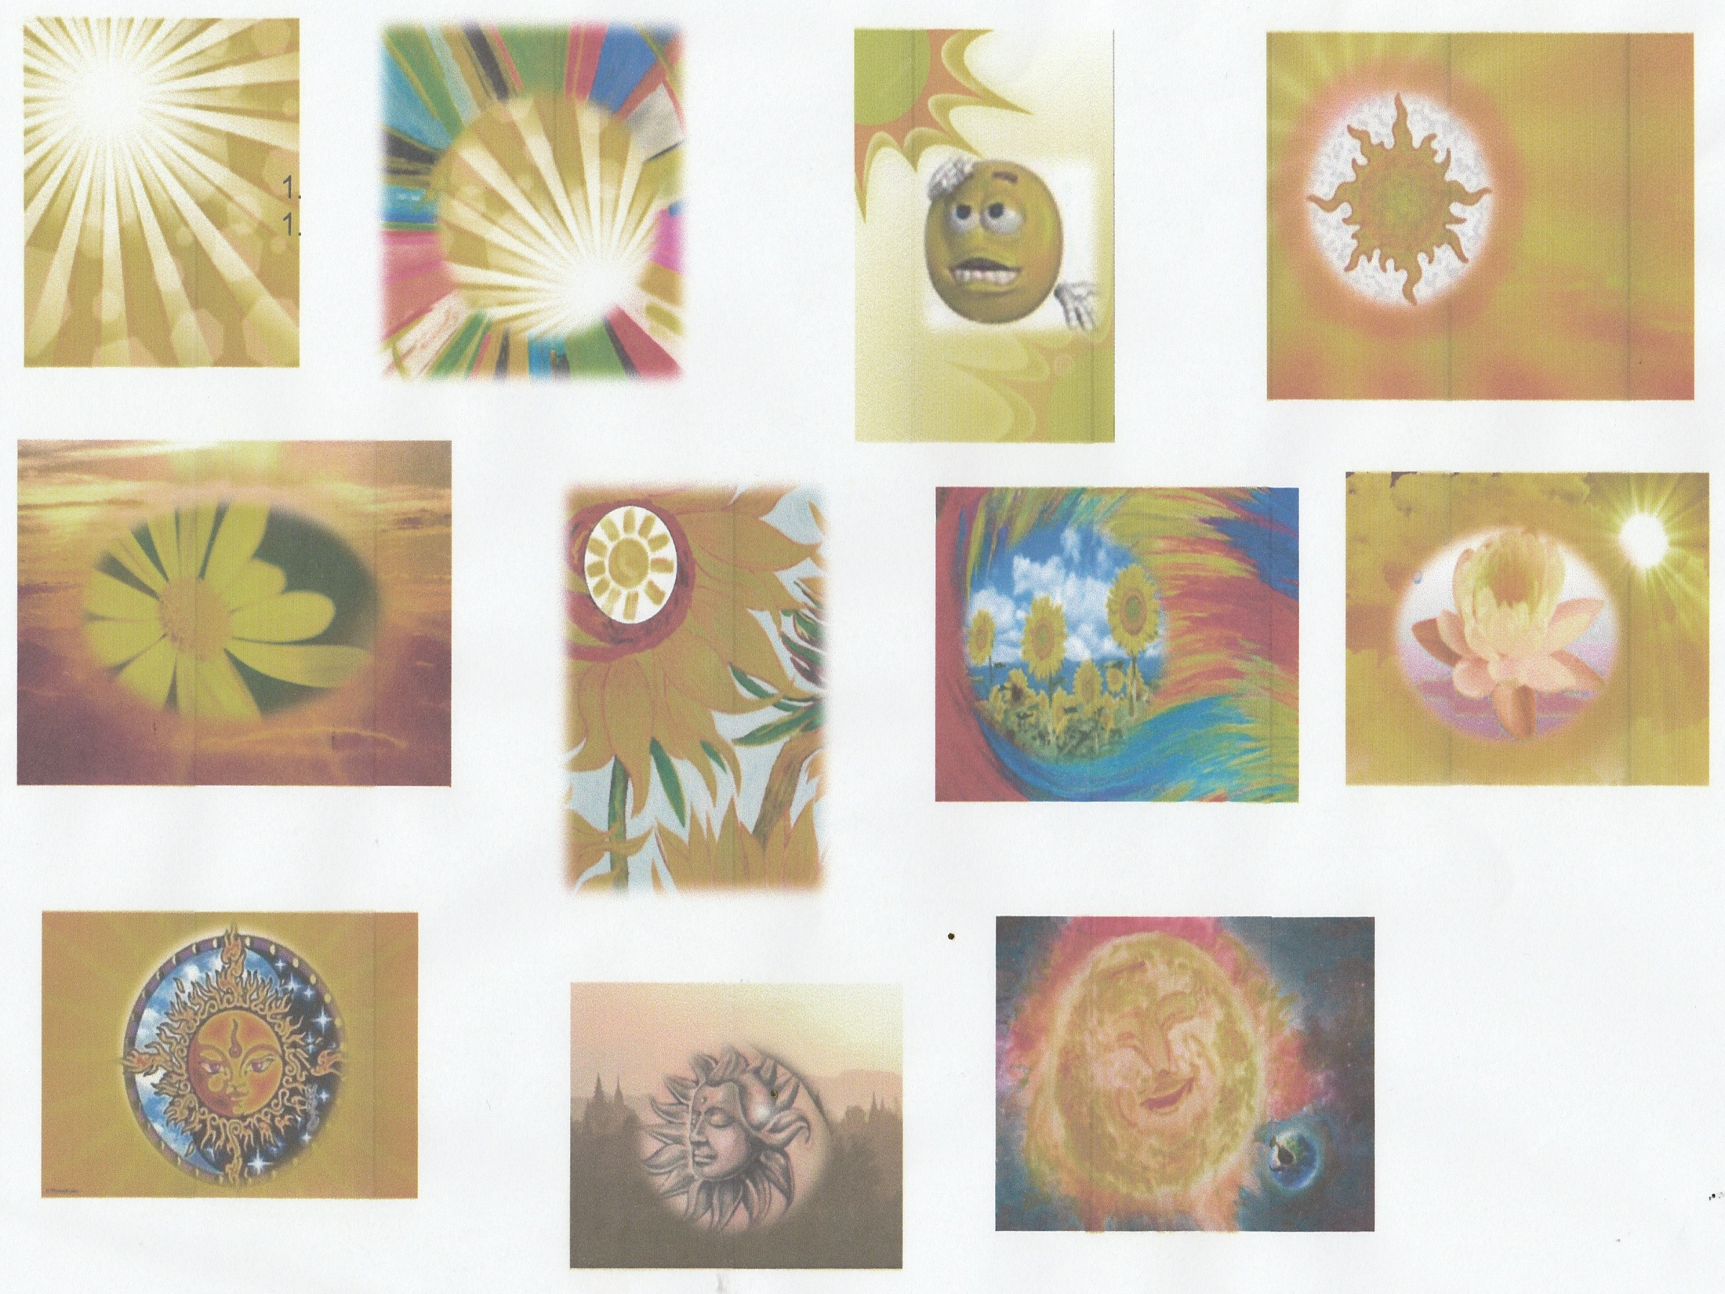

Slide 23
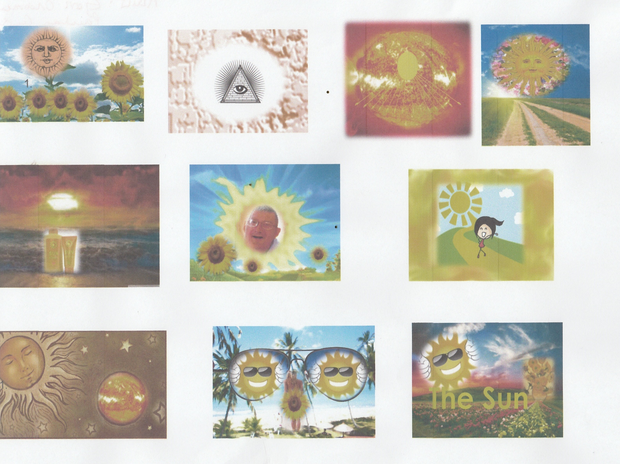

Slide 24
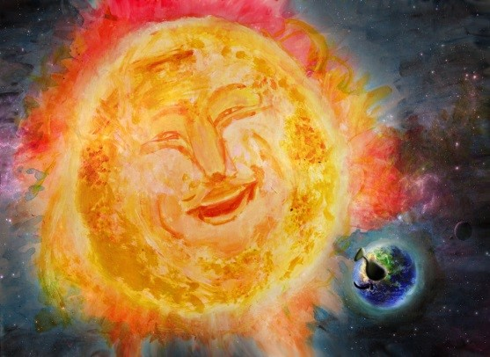

Slide 25
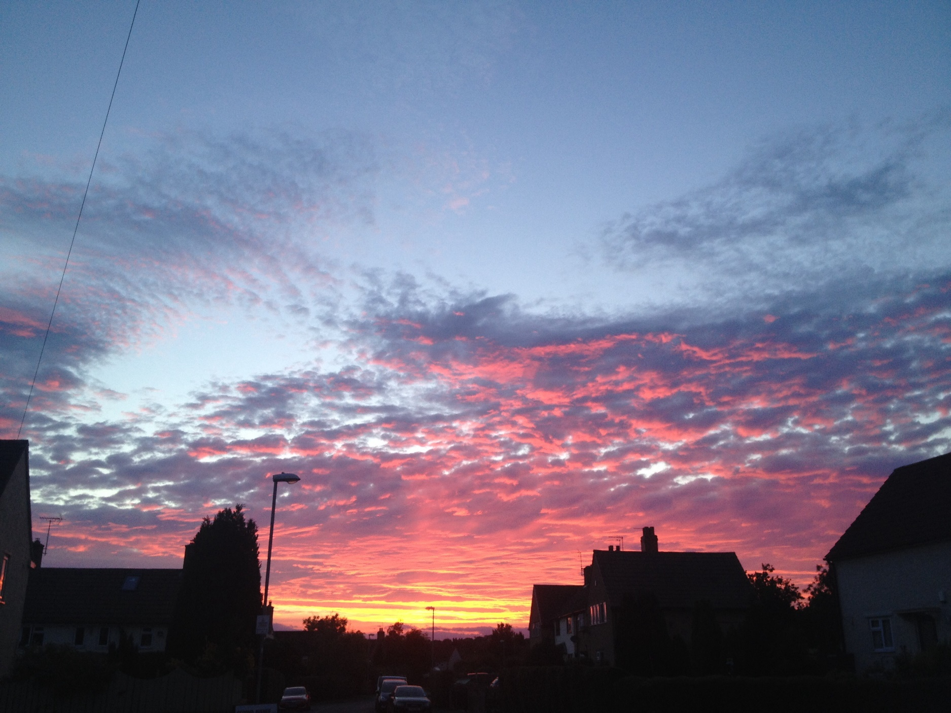

Slide 26
Rebecca Marriott (adult)

Slide 27
Thank you Macsen! Eye gaze composition

Slide 28
Jemima Hughes (adult)

Slide 29
CRC Clinic Dublin Jack, Aoife, Finn, Luke, Oana, Ciara

Slide 32
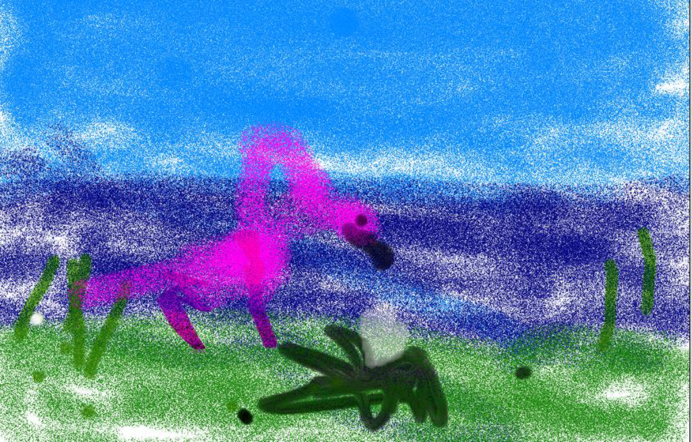
Hollie,7 eye gaze

